Slide 1
Lecture 12. Distributed Machine Learning Systems
Wenguang Chen
Dept. of Computer Science and Technology
Tsinghua University

Slide 2
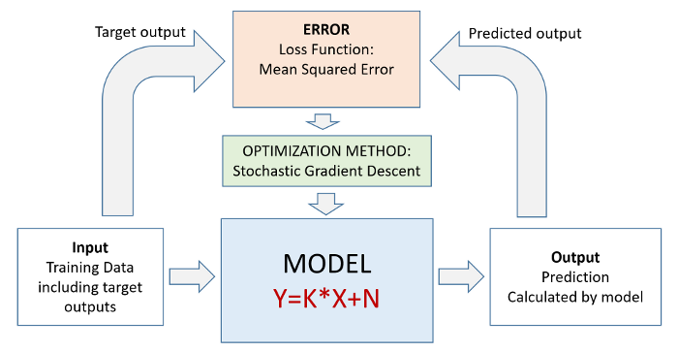
A machine learning training process
Challenges:
The models are getting more and more complicated
The compute power required is ever increasing
*https://in.pinterest.com/pin/684758318328612307/

Slide 3
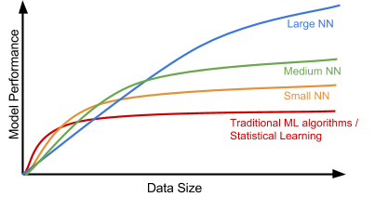
Why large models?
Realize the value in big data

Slide 4
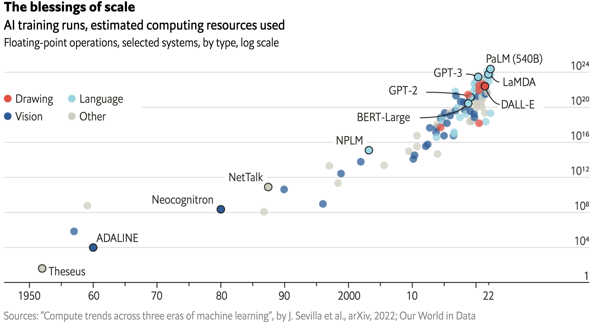
Large models are popular today

Slide 5
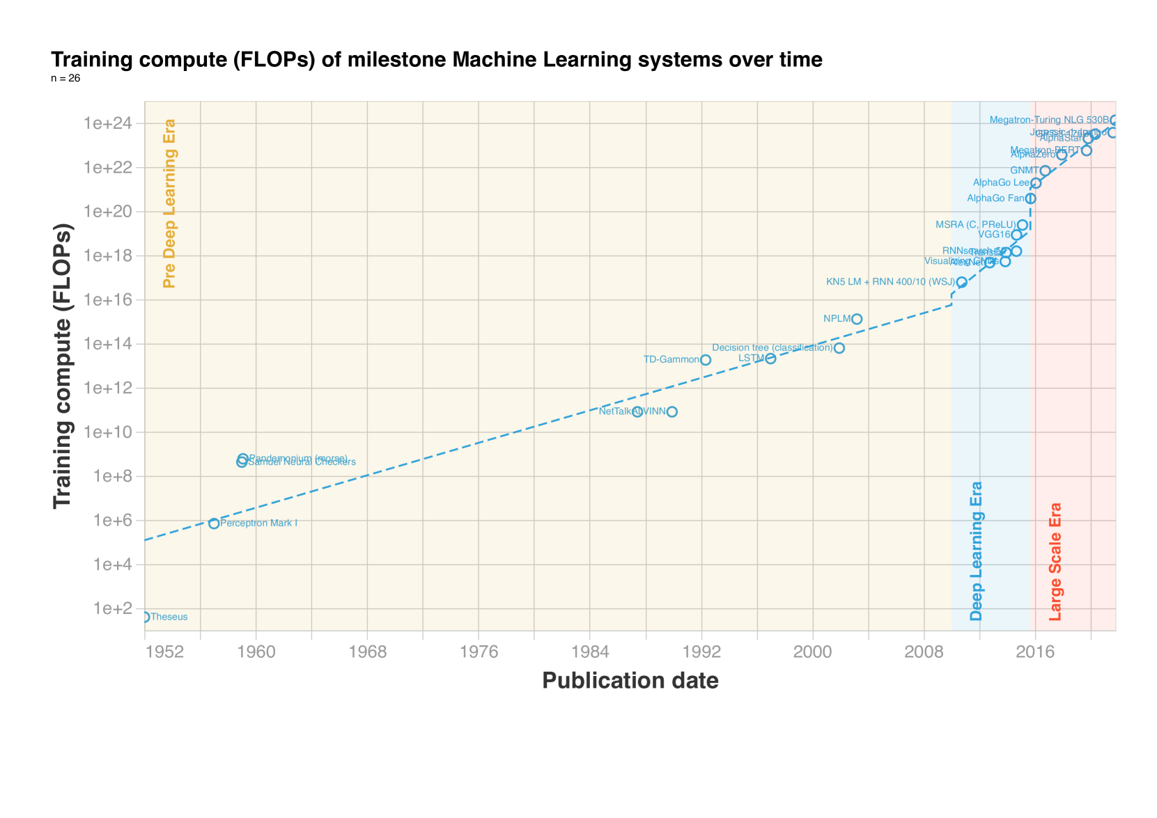

Slide 6
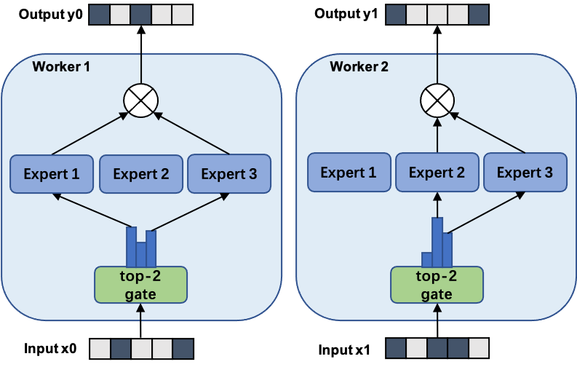
Switch Transformer – 1 Trillion parameters
Mixture of Experts (MoE) algorithm

Slide 7
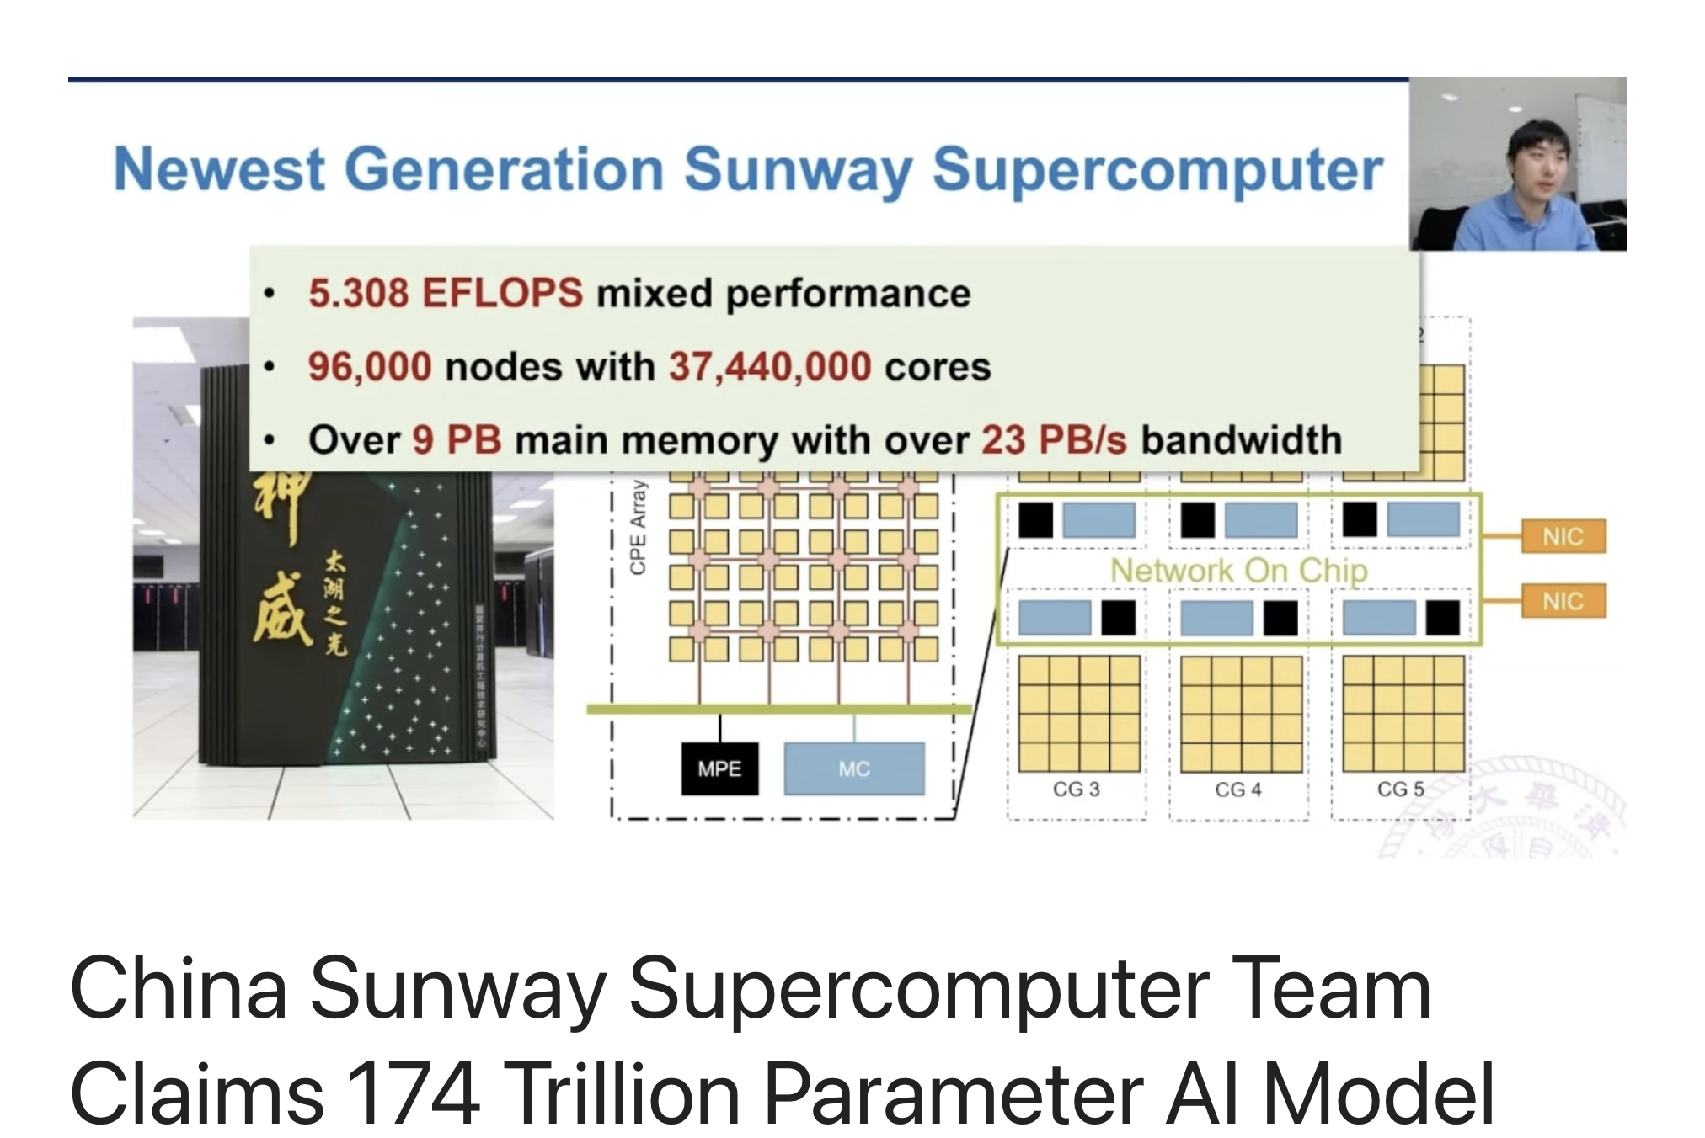
100 Trillion parameters

Slide 8
Size of model
@Fp 16( 2bytes per parameter)
GPT-3 175B parameters require : 350GB
Switch Transformer 1T parameters require: 2TB
The most update to date GPU nVidia A 100
80 GB on board memory
How to train models larger than the GPU memory?

Slide 9
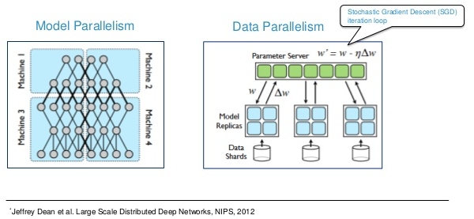
Distributed Machine Learning
Data parallel
model is replicated, data is partitioned
Fast training, but does not address the model size issue
Model parallel
model is partitioned, data is replicated

Slide 10

Data Parallel Training
In each iteration:
each worker reads different mini-batch of size M, produces gradient
communicate to produce aggregated gradient
update weights
weights
weights
weights
Communication
gradient
gradient
gradient

Slide 11
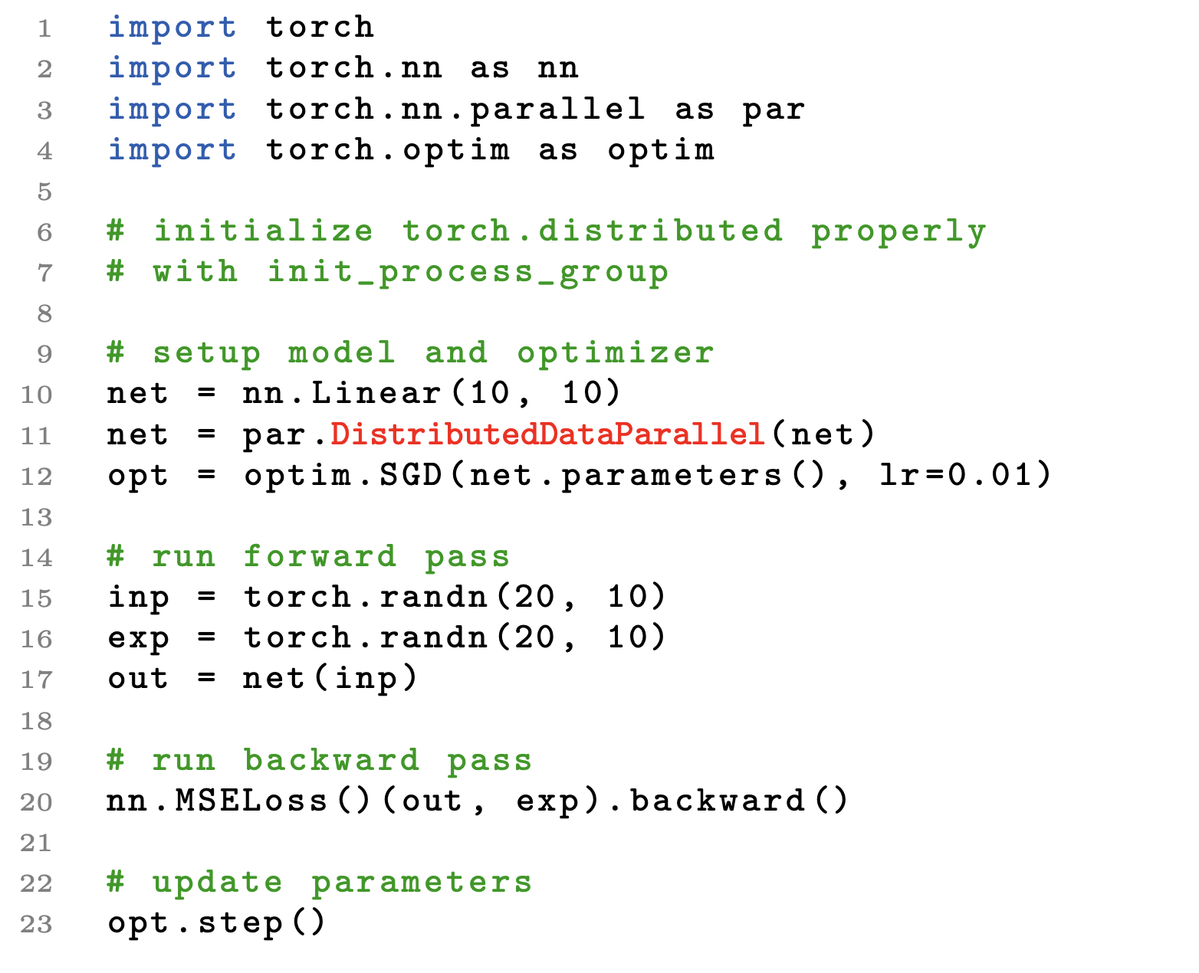
Programming Interfaces

Slide 12
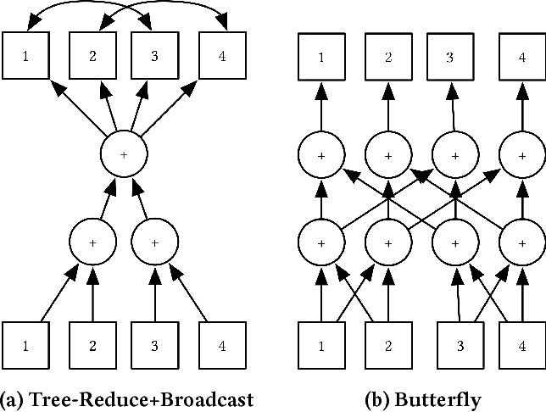

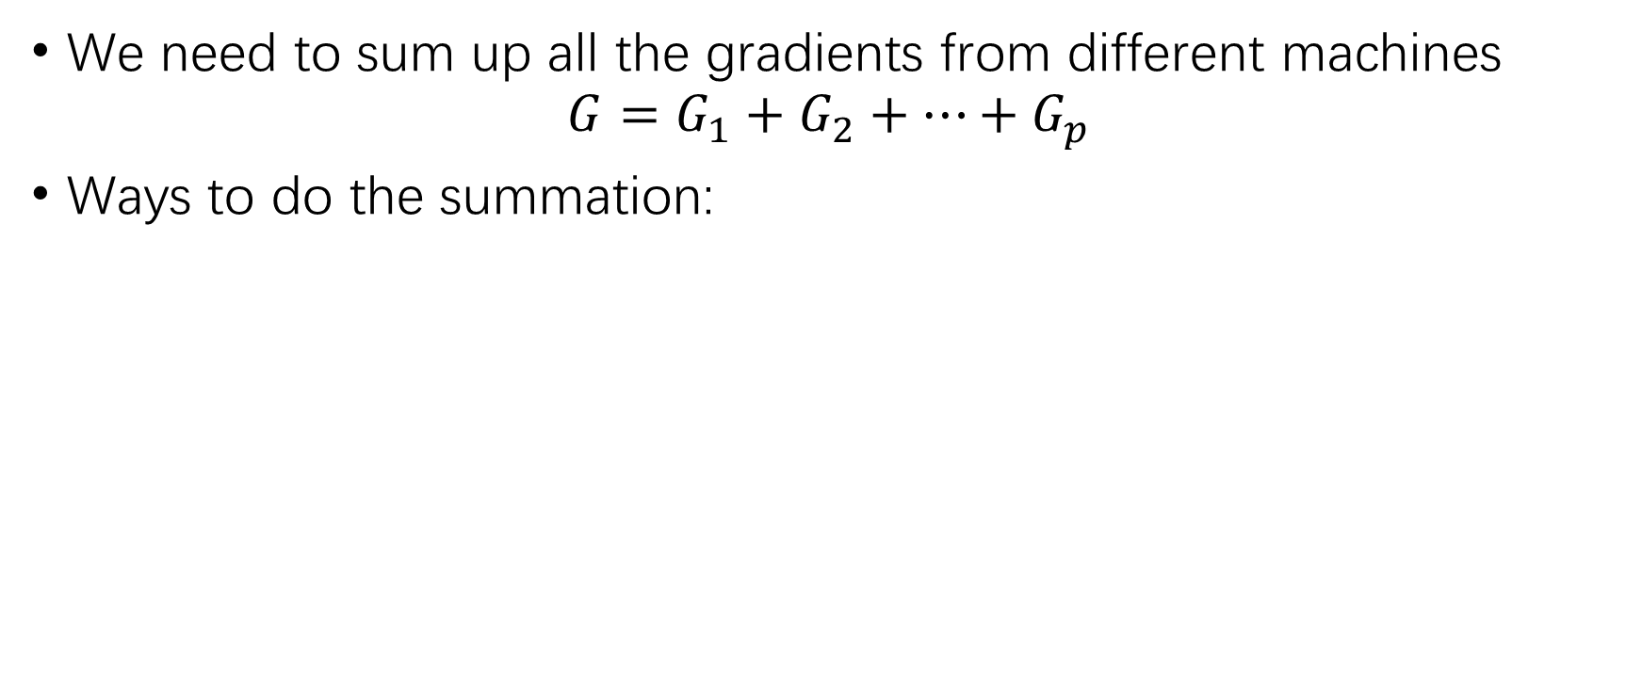




AllReduce to get global gradients
We need to sum up all the gradients from different machines
$$G=G_{1}+G_{2}+…+G_{p}$$
Ways to do the summation:
$$G_{}$$
$$G_{1}$$
$$G_{2}$$
$$G_{3}$$
$$G_{p}$$
O(NP)
O(NlogP)
O(N)

Slide 13
Parameter Server
Parameter server
2. Aggregate gradient for each parameter
1. Push gradients
Model replicas
Data partitions
Workers
The parameter servers may be overloaded.
Easy to adopt asynchronous training
But it is does not have good performance
Notes:
One popular way to synchronize between the workers is using parameter servers.
In this approach, after a worker produces a gradient, it will push the gradient to the parameter server.
The parameter server will aggregate the gradients from the workers, and then use the aggregated gradient to update the model.

Slide 14
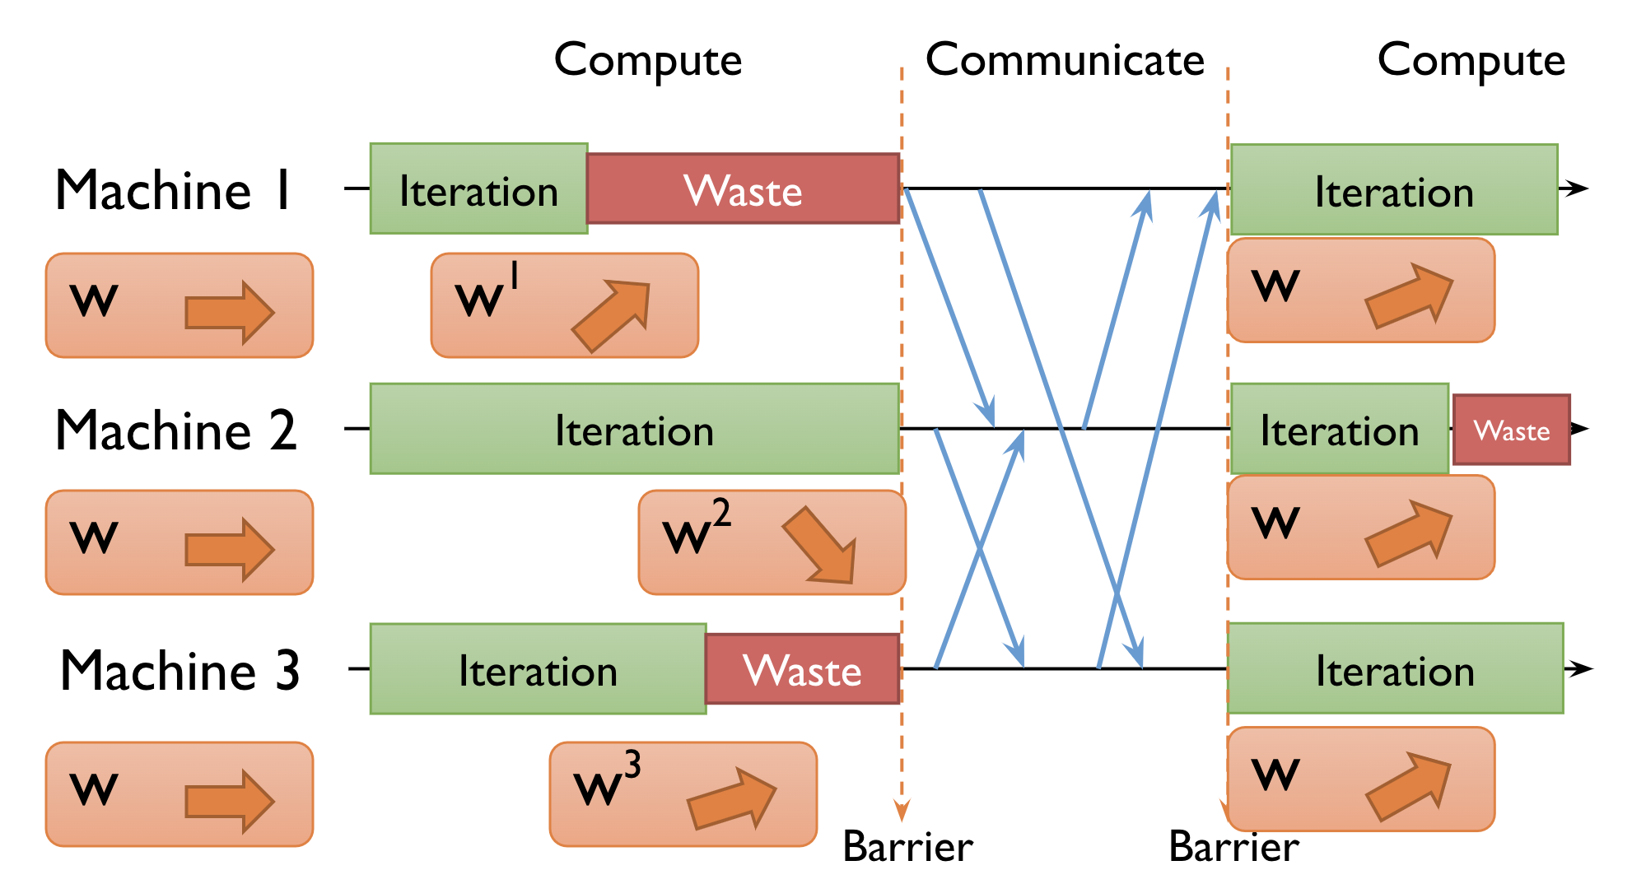
Synchronous training

Slide 15
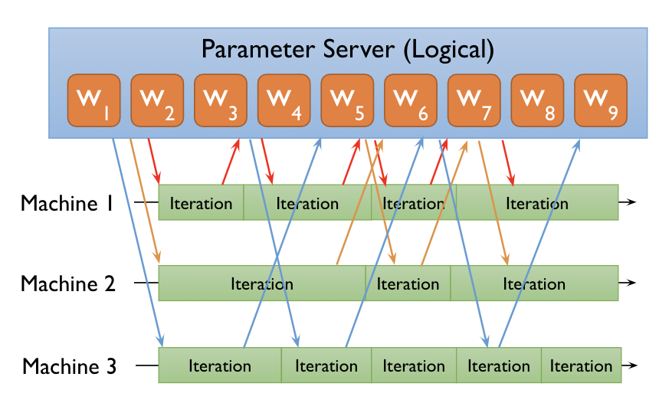
Asynchronous Training

Slide 16
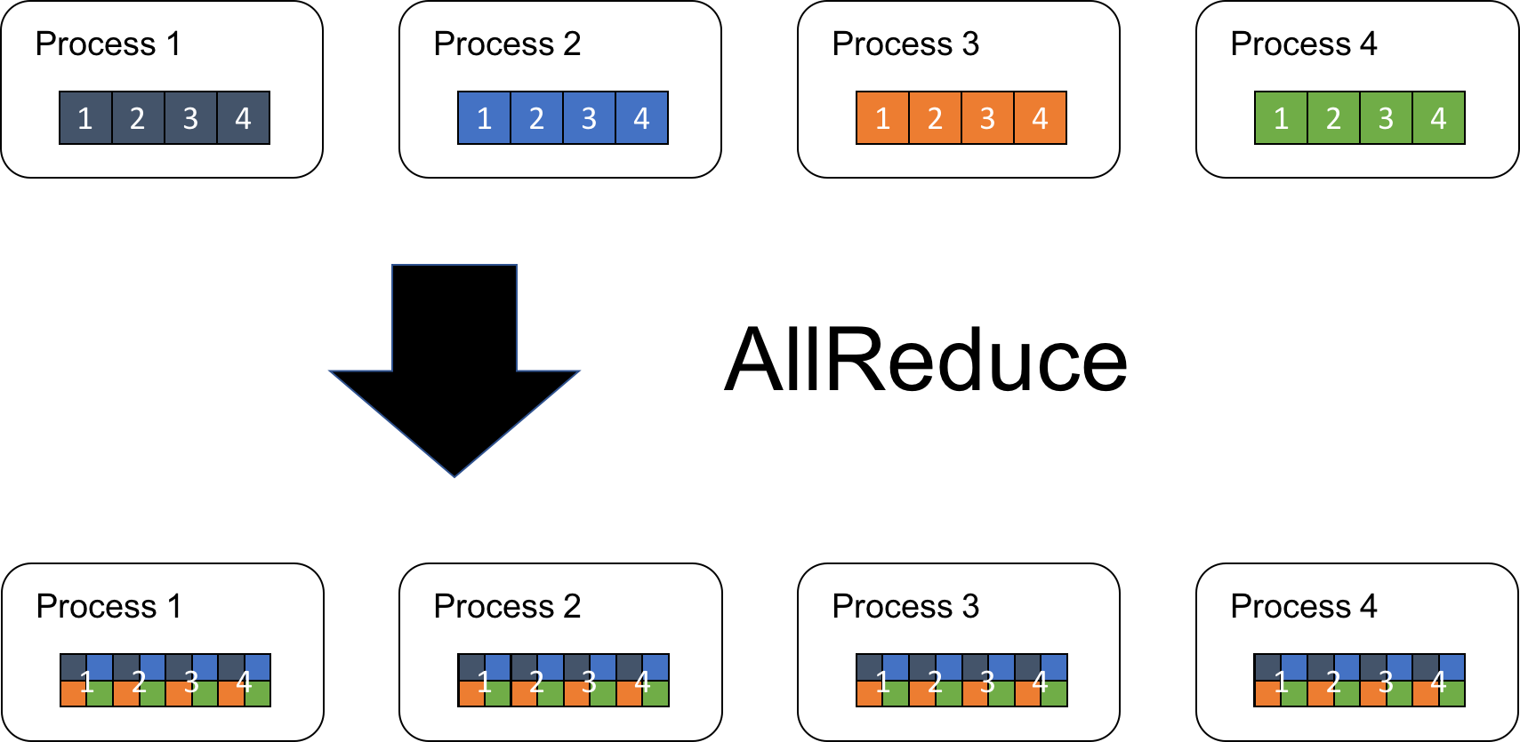
AllReduce to get global gradients
https://tech.preferred.jp/en/blog/technologies-behind-distributed-deep-learning-allreduce/

Slide 17
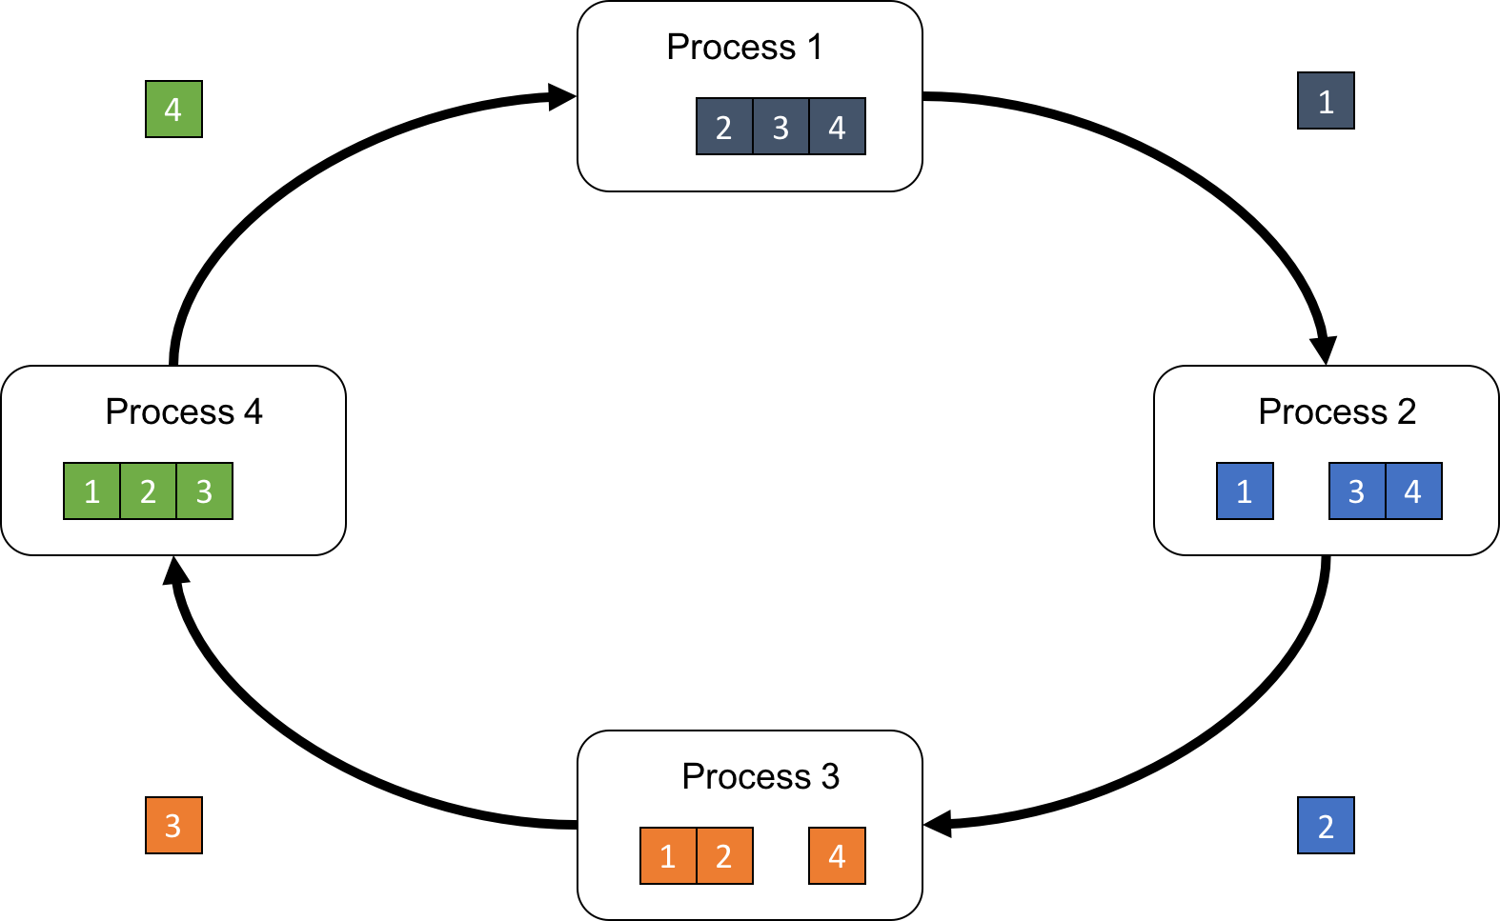
Ring Reduce(1)

Slide 18
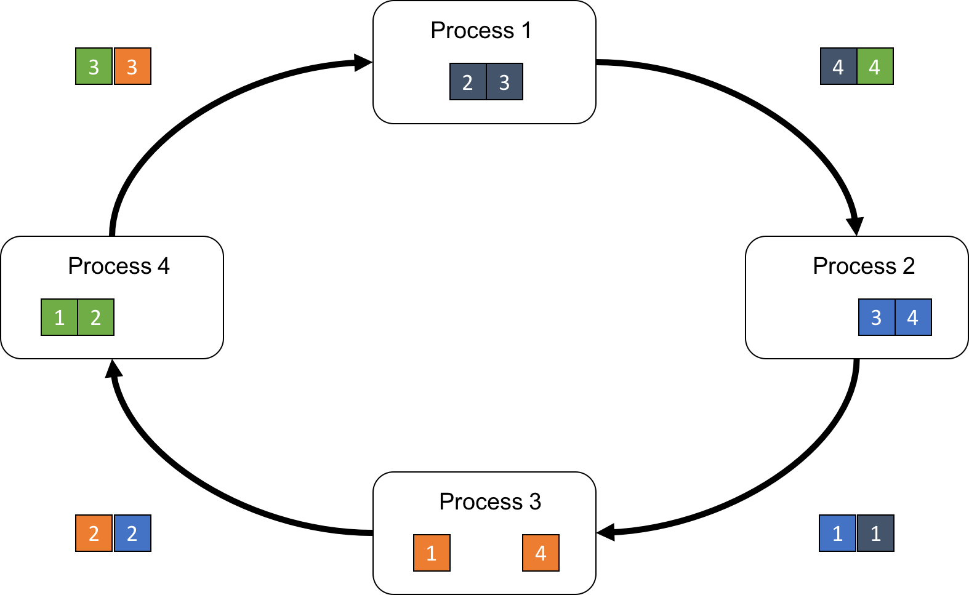
Ring Reduce(2)

Slide 19
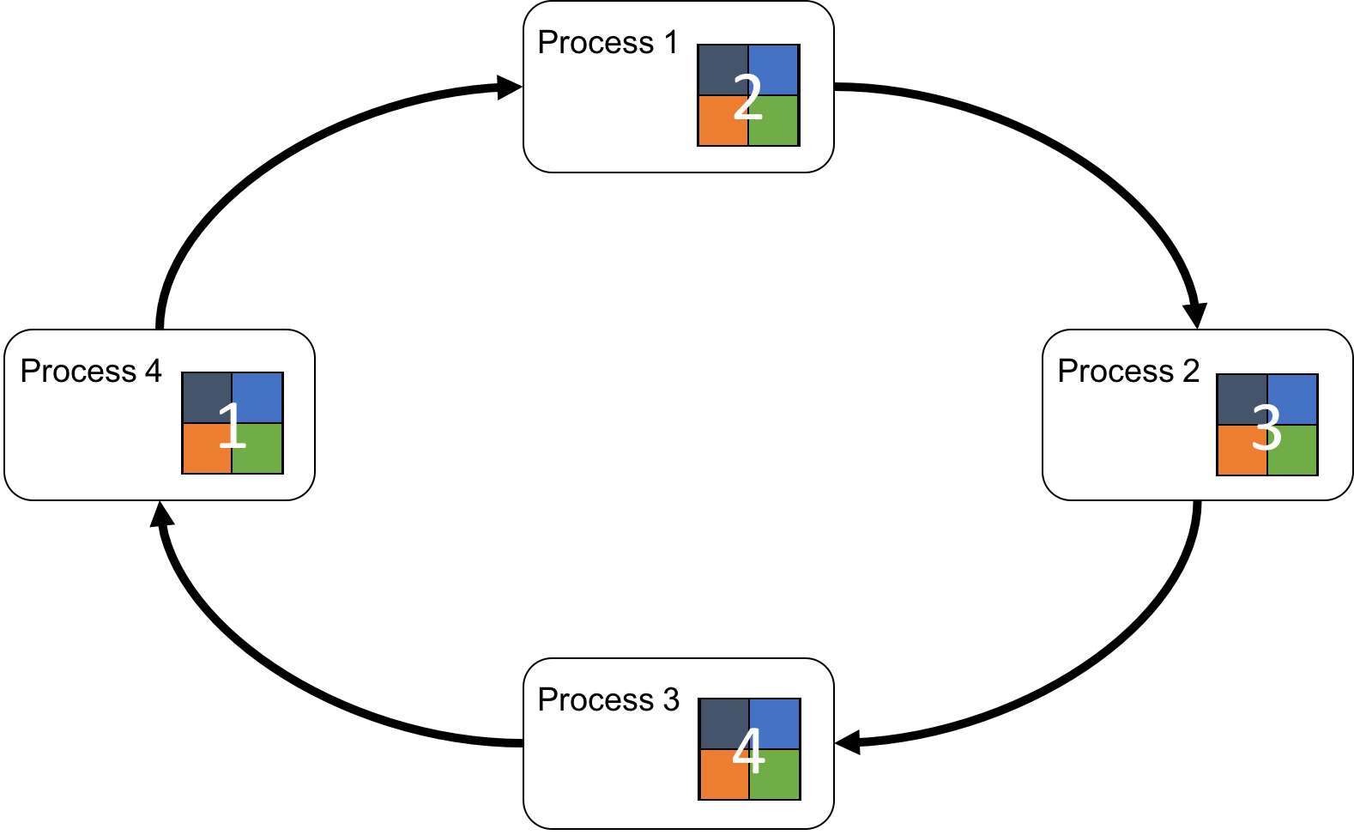
Ring Reduce(3)

Slide 20
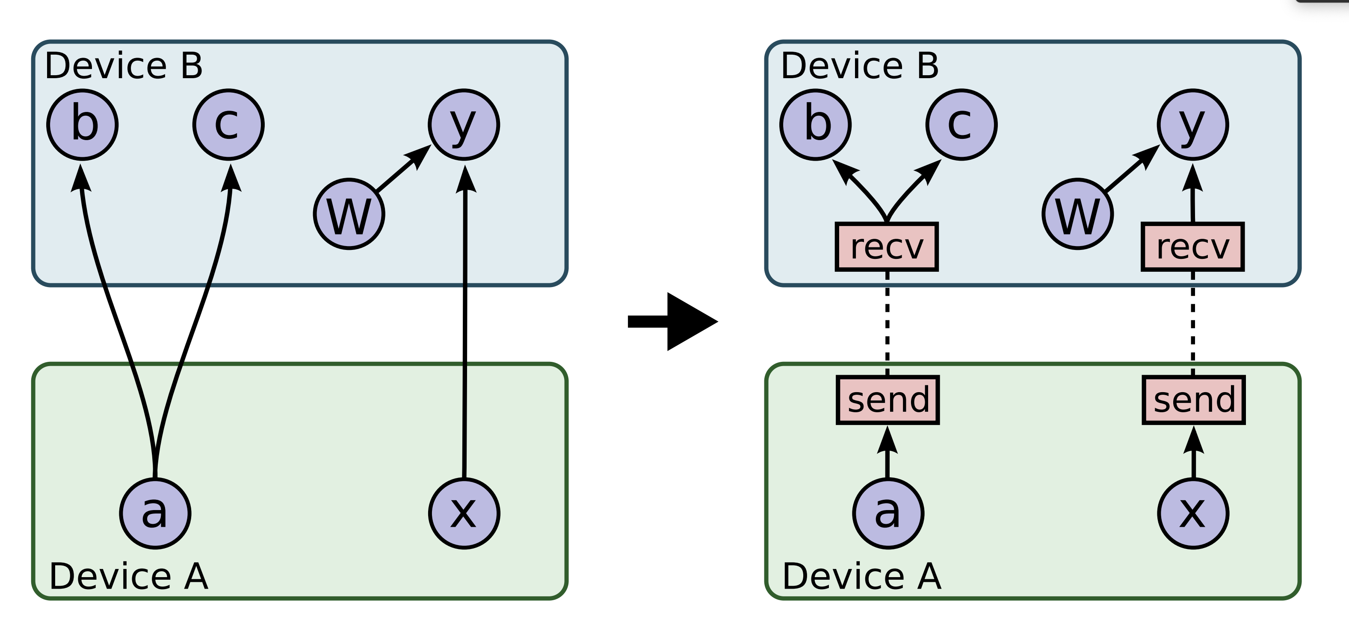
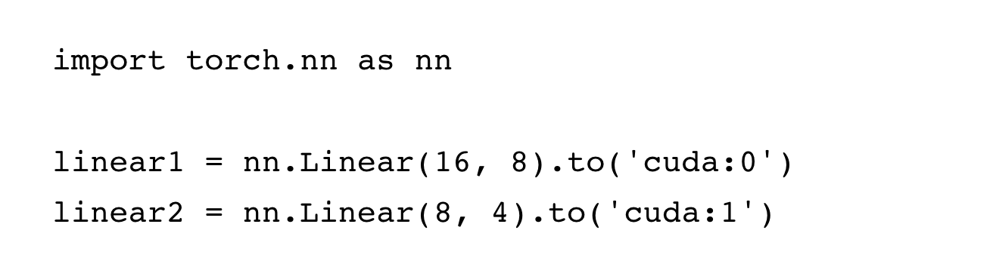
Model Parallel Training

Slide 21
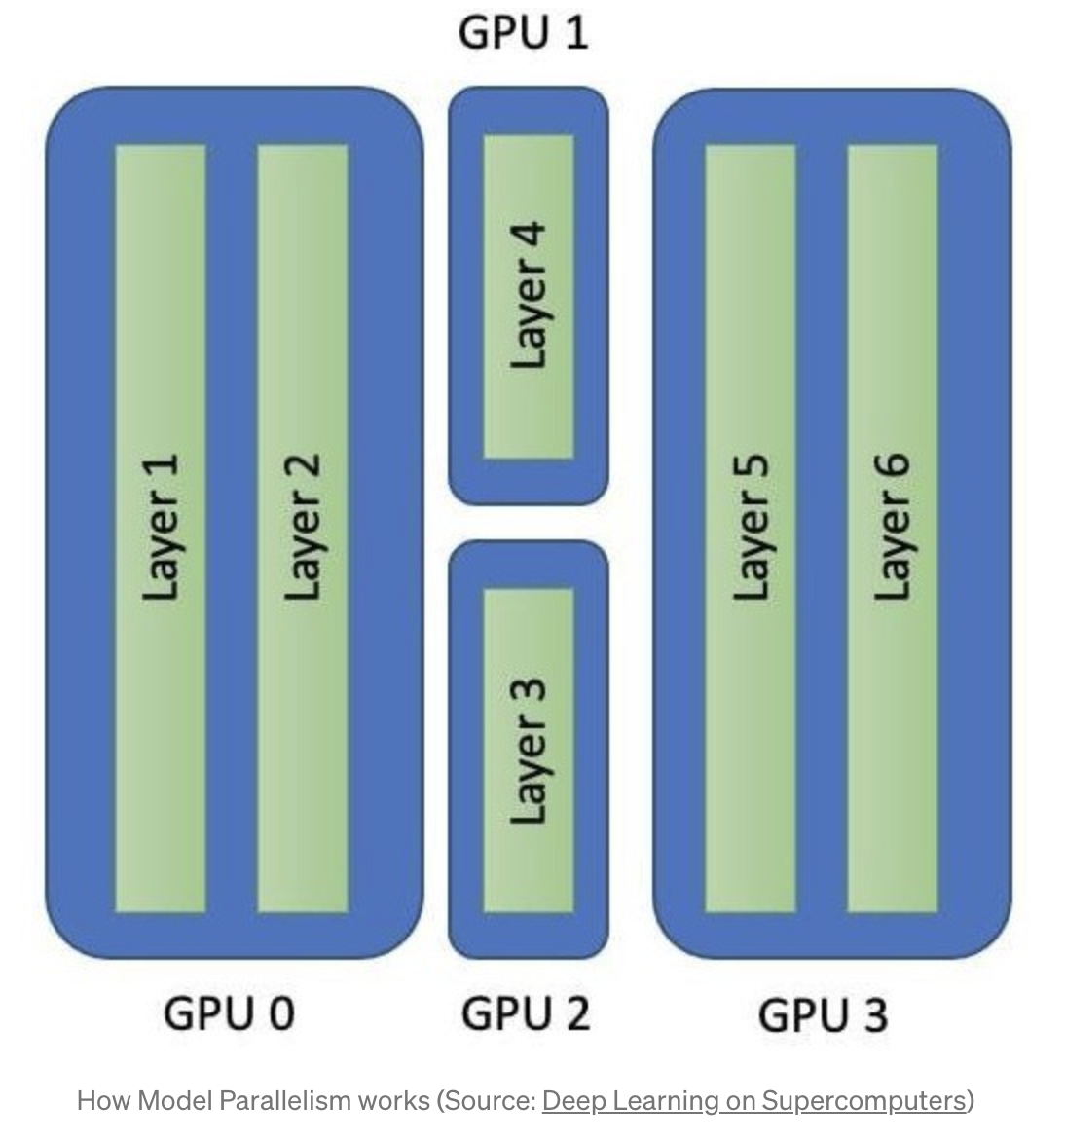
Model Parallelism for Neural Networks

Slide 22
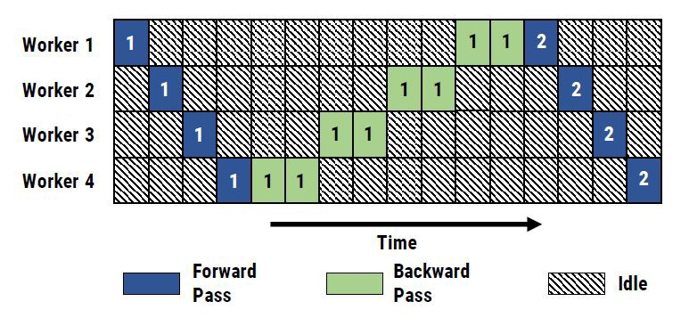
Model Parallel Training
Model parallel training with 4 workers. Numbers indicate batch ID

Slide 23
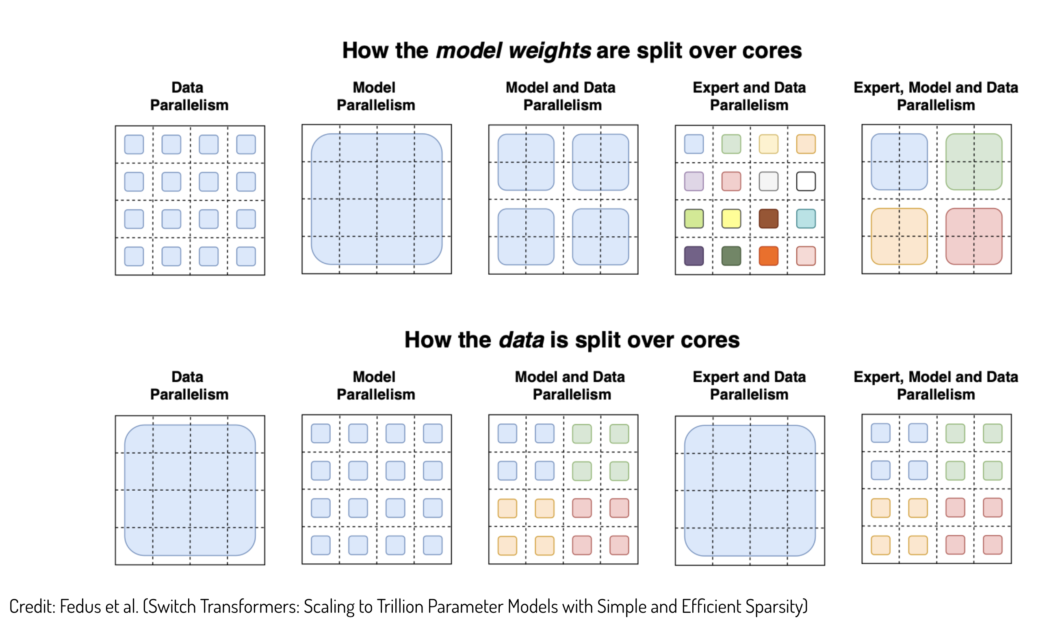
How models and data distributed in different parallel mode

Slide 24
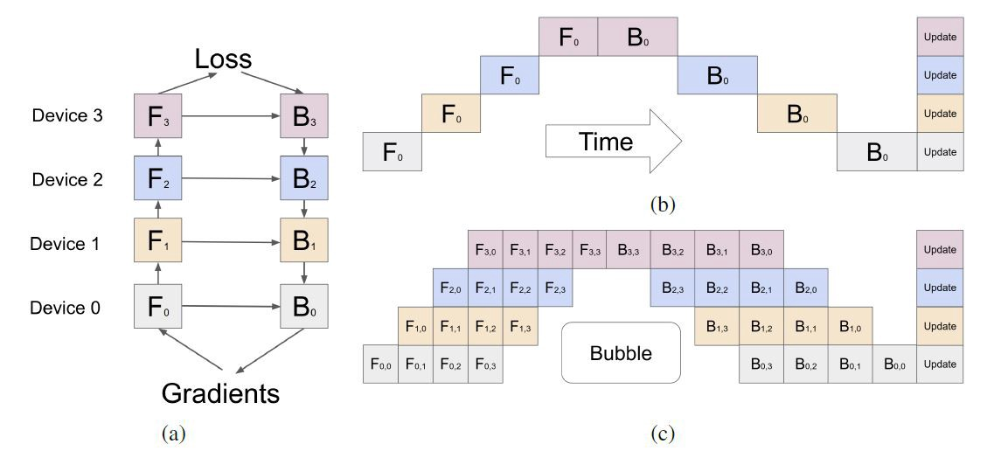
Pipeline Parallel Training(Sync)
Huang, Yanping, et al. “Gpipe: Efficient training of giant neural networks using pipeline parallelism.” arXiv preprint arXiv:1811.06965 (2018).

Slide 25
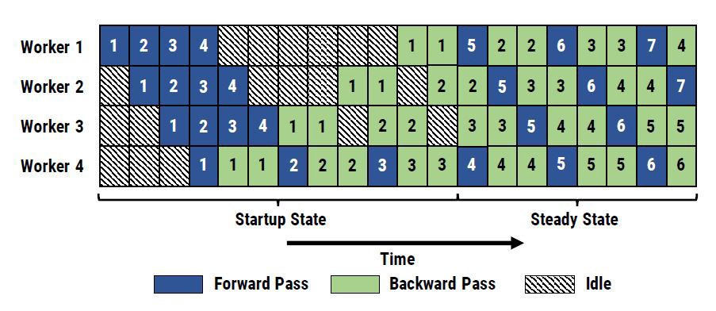
Pipeline Parallel Training(Async)
Narayanan, Deepak, et al. “PipeDream: generalized pipeline parallelism for DNN training.” Proceedings of the 27th ACM Symposium on Operating Systems Principles. 2019.

Slide 26
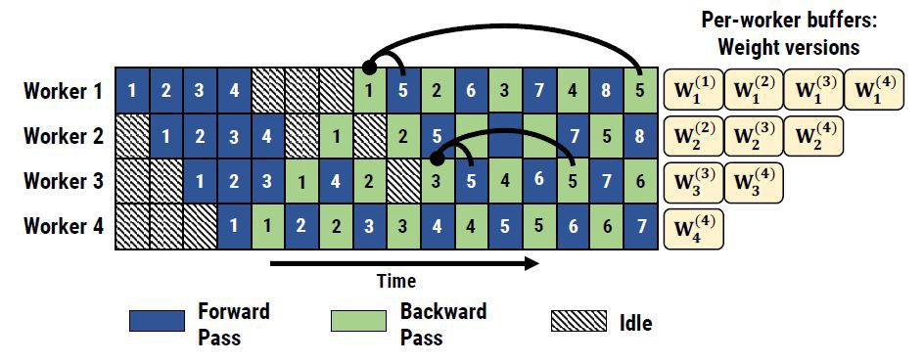
More memory required for async training
Multiple version of parameters are maintained because of the asynchronous training

Slide 27
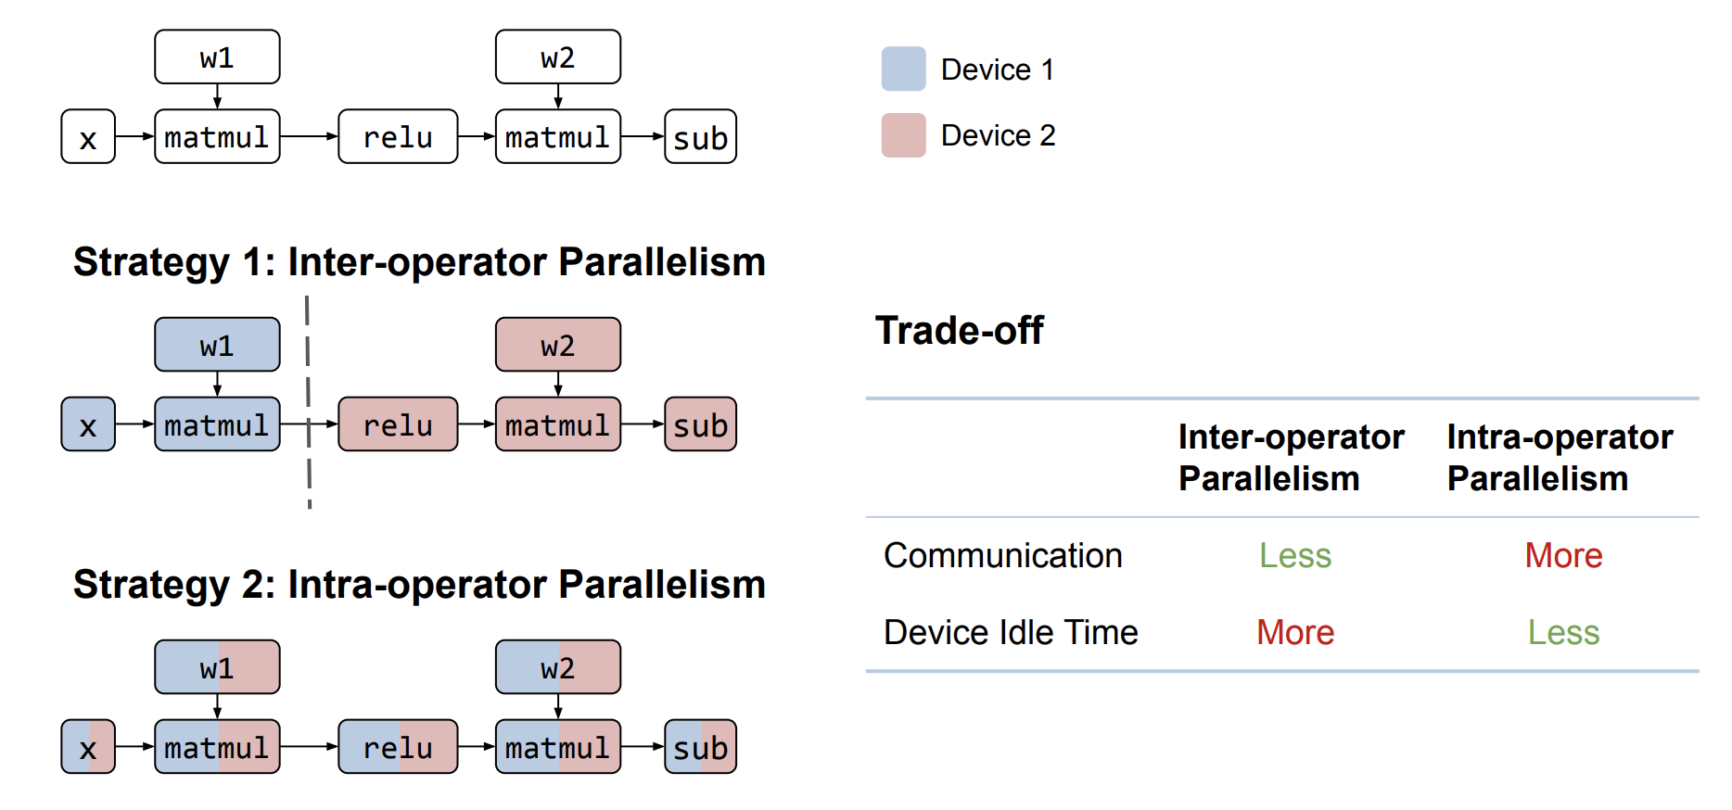
Challenges to computer systems : How to partition the model and choose parallelism?

Slide 28
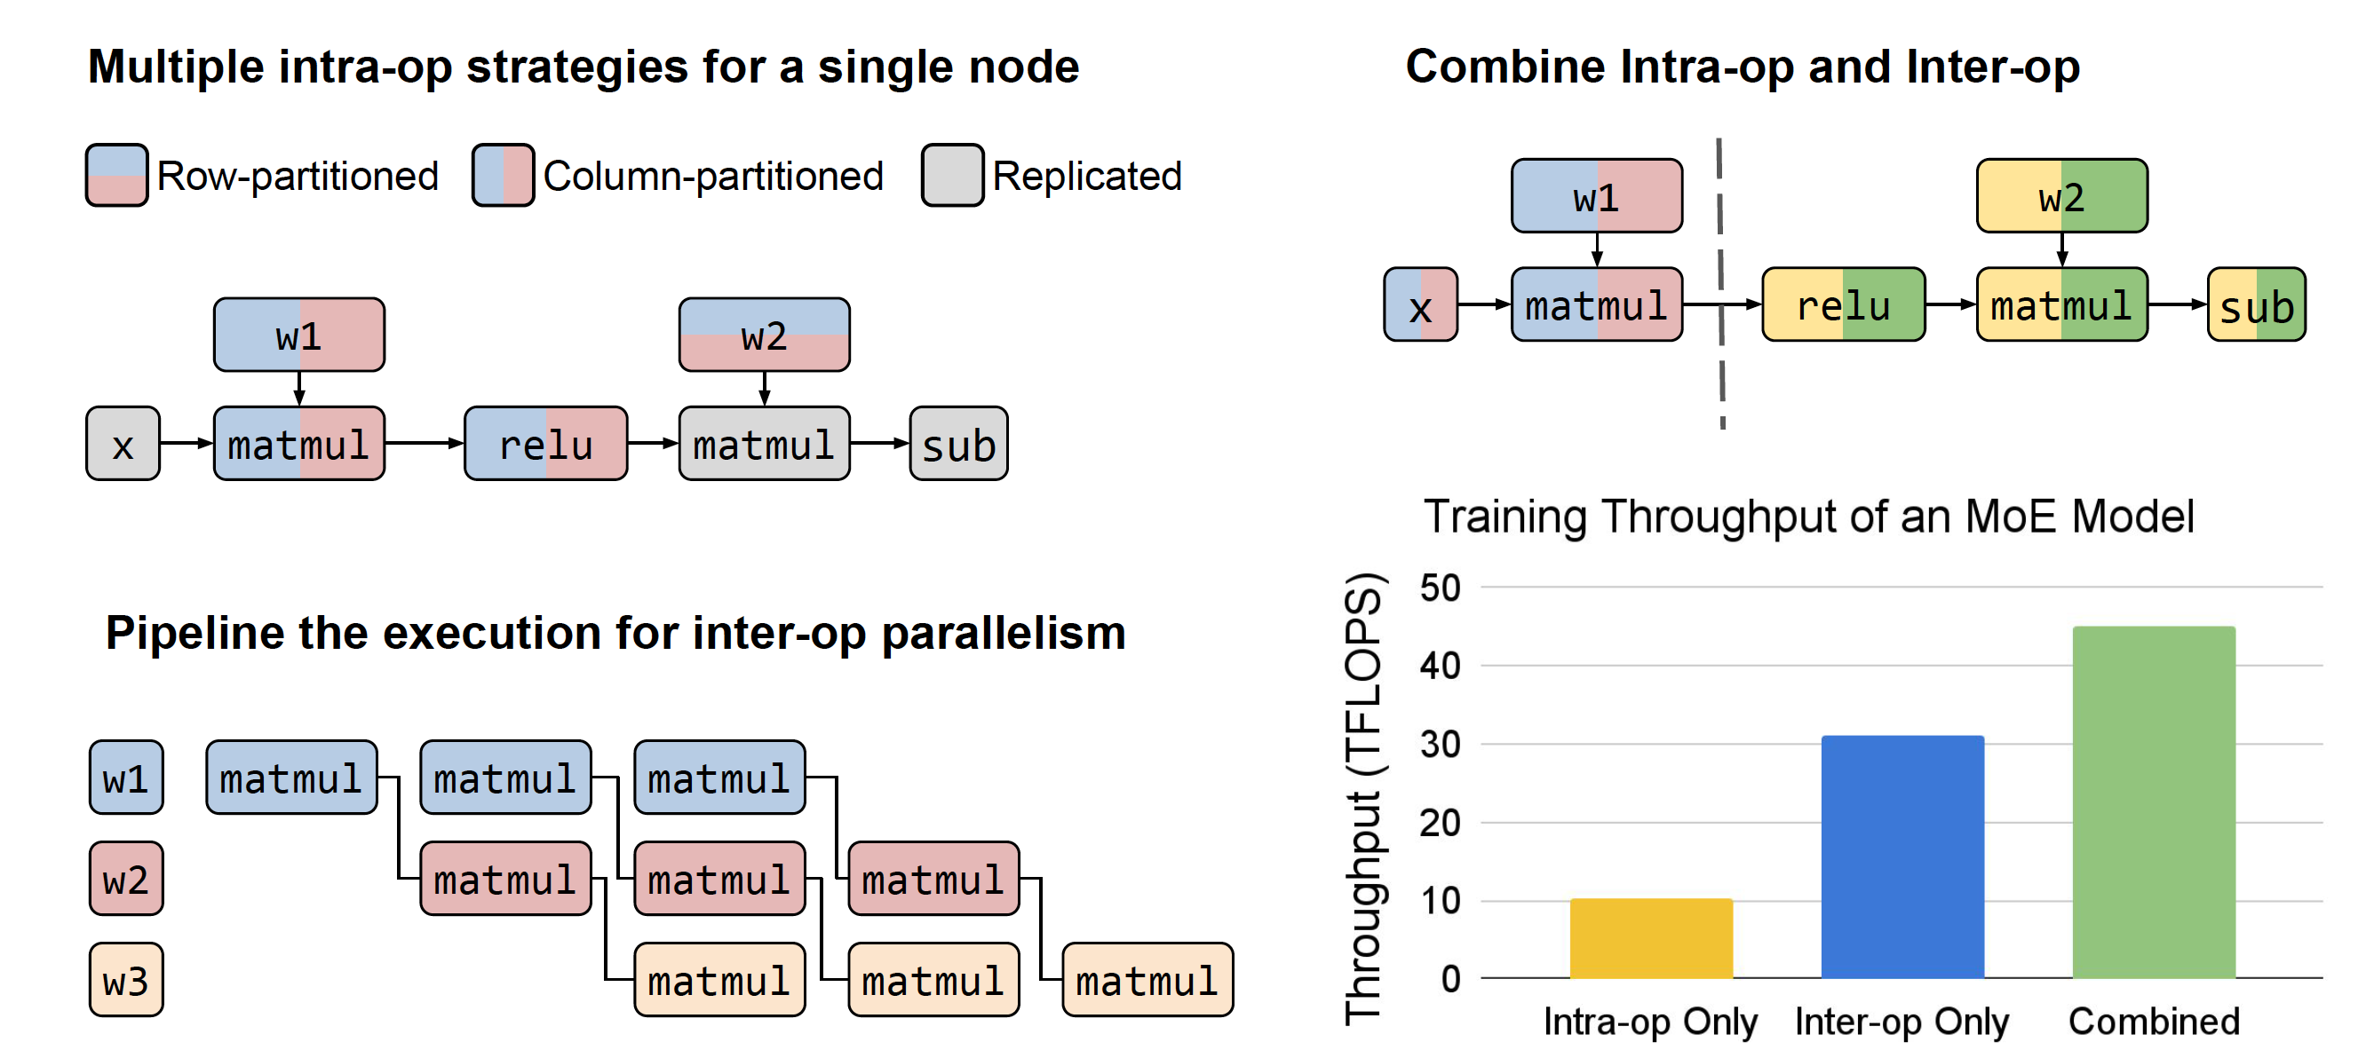
Multiple strategies for both intra- and inter-op parallelism

Slide 29
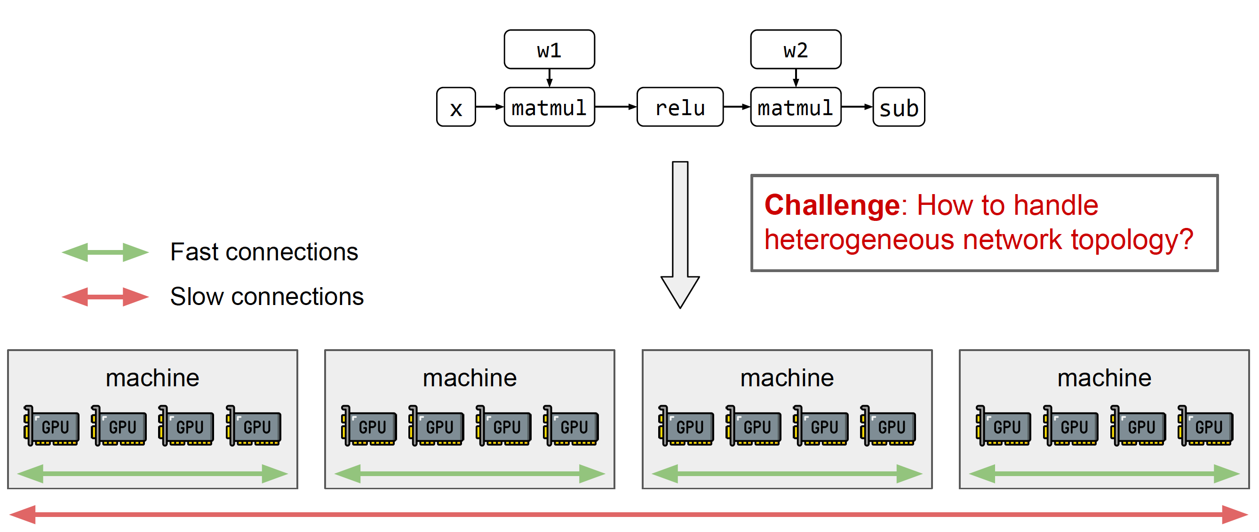
Mapping to underlying hardware

Slide 30
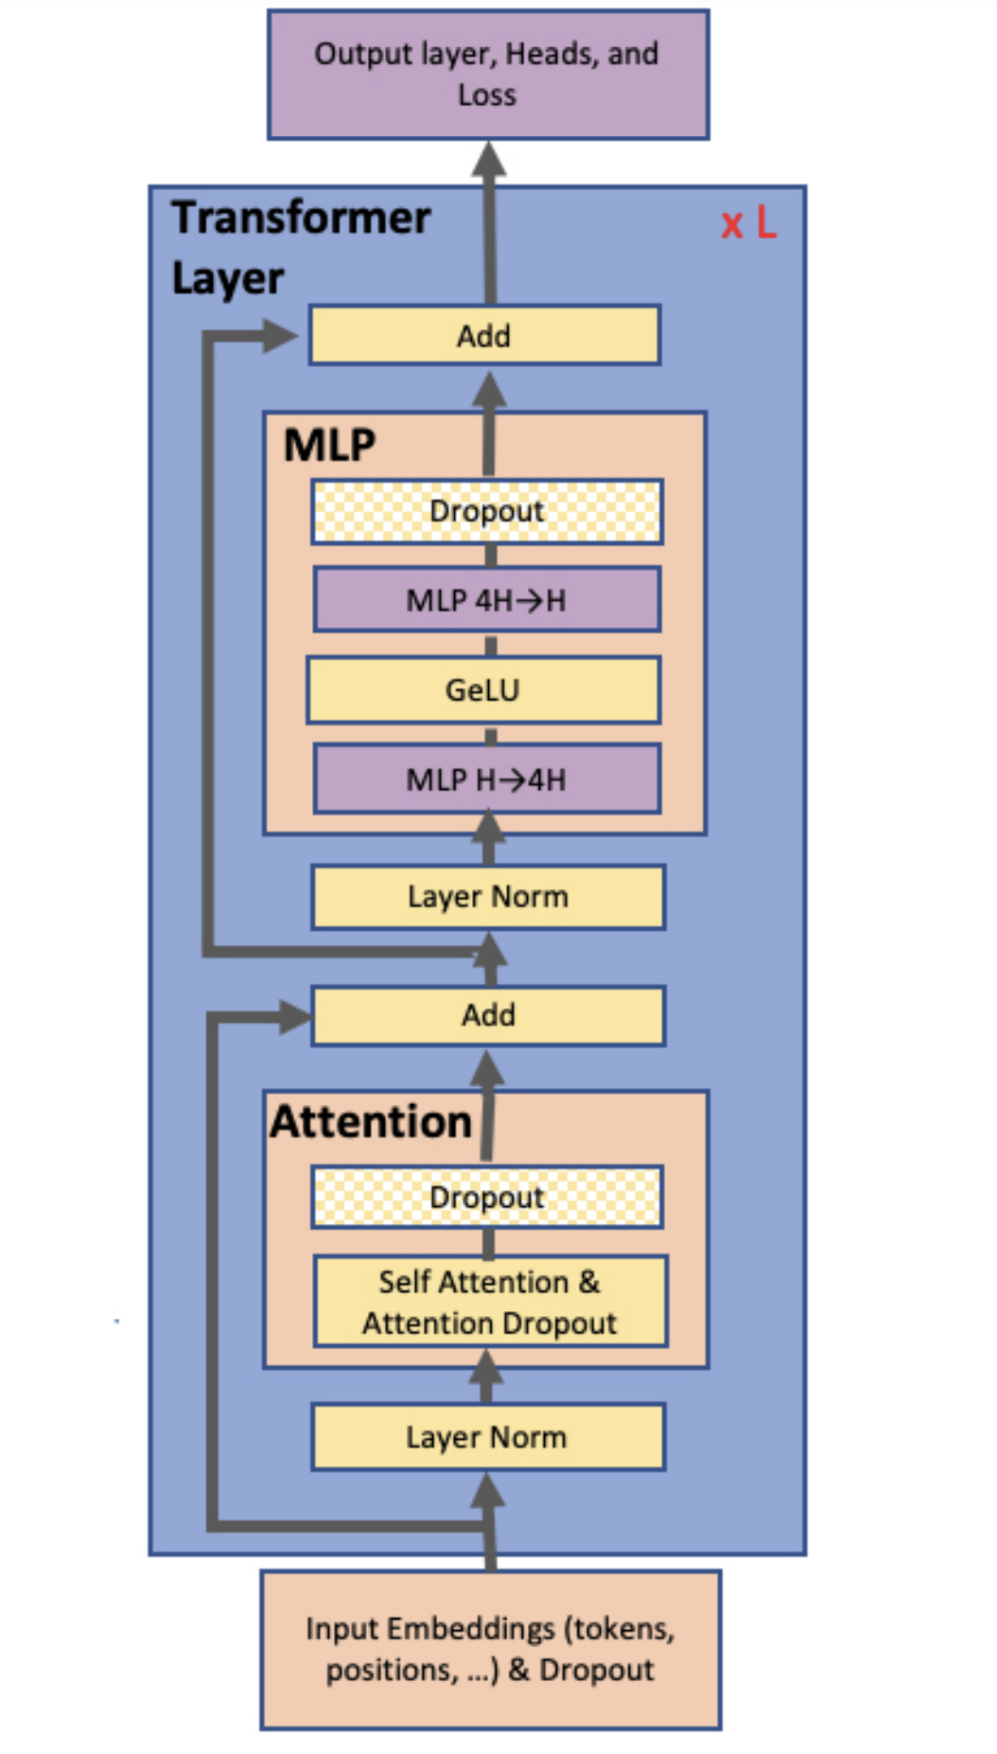
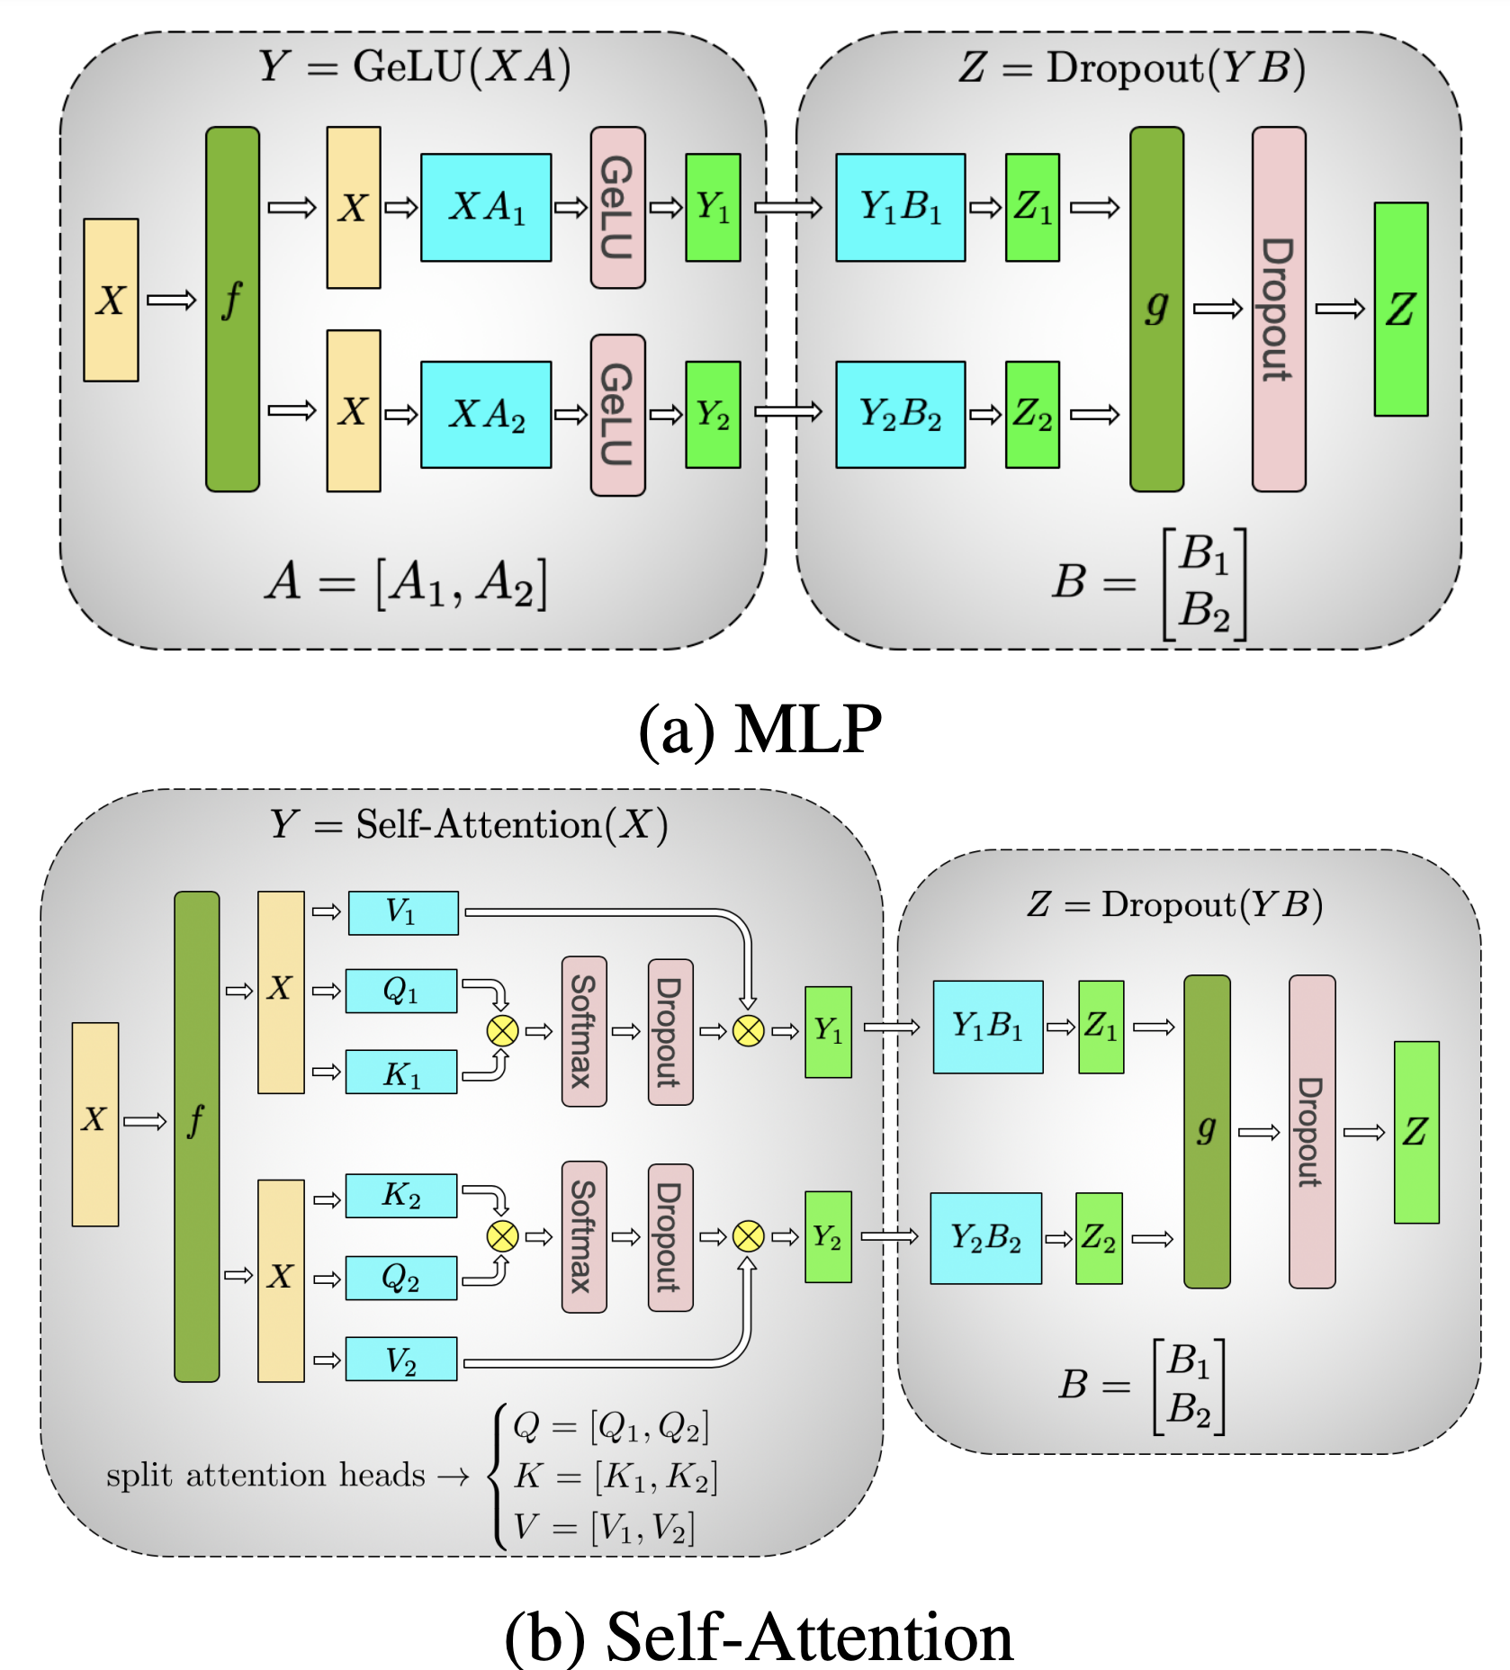
Exsiting work:Megatron-LM : Manual Partition of Transformers

Slide 31
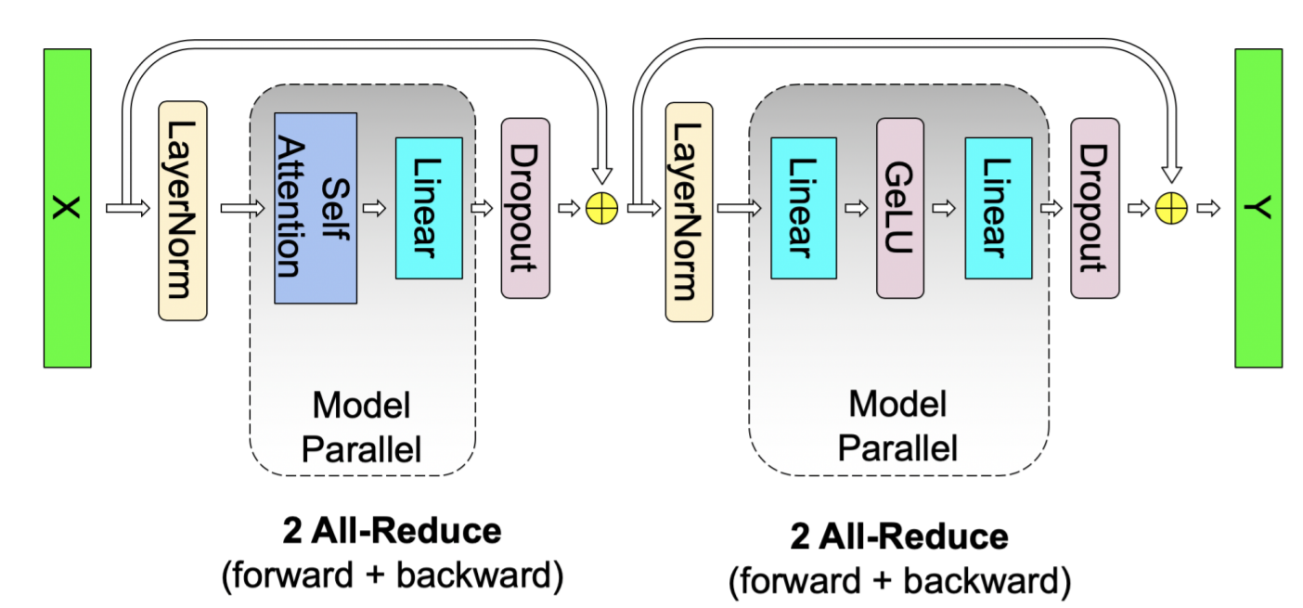
Megatron-LM : Manual Partition of Transformers

Slide 32
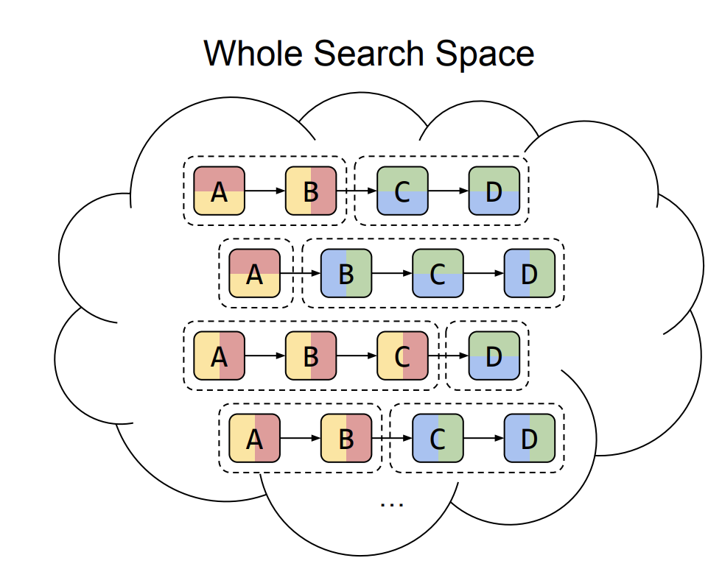
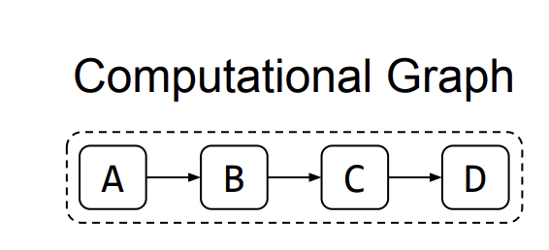
Can we find the good partition for a large model automatically
Support both intra and inter-op parallelism, as well as pipeline parallelism
There are huge search space and it is a combinatory optimization problem

Slide 33
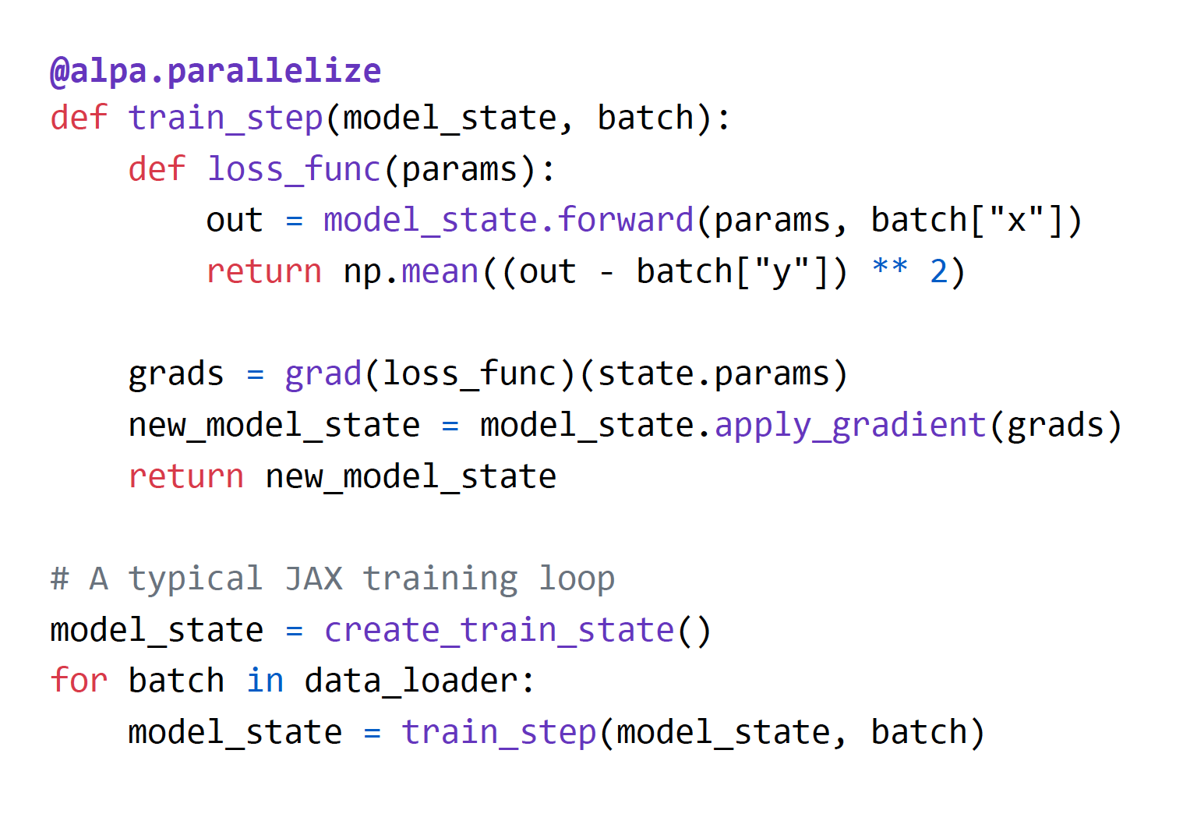
Alpa
Automatic parallelize the model training with just one line annotation
Alpa: Automating Inter- and Intra-Operator Parallelism for Distributed Deep Learning,OSDI 2022

Slide 34
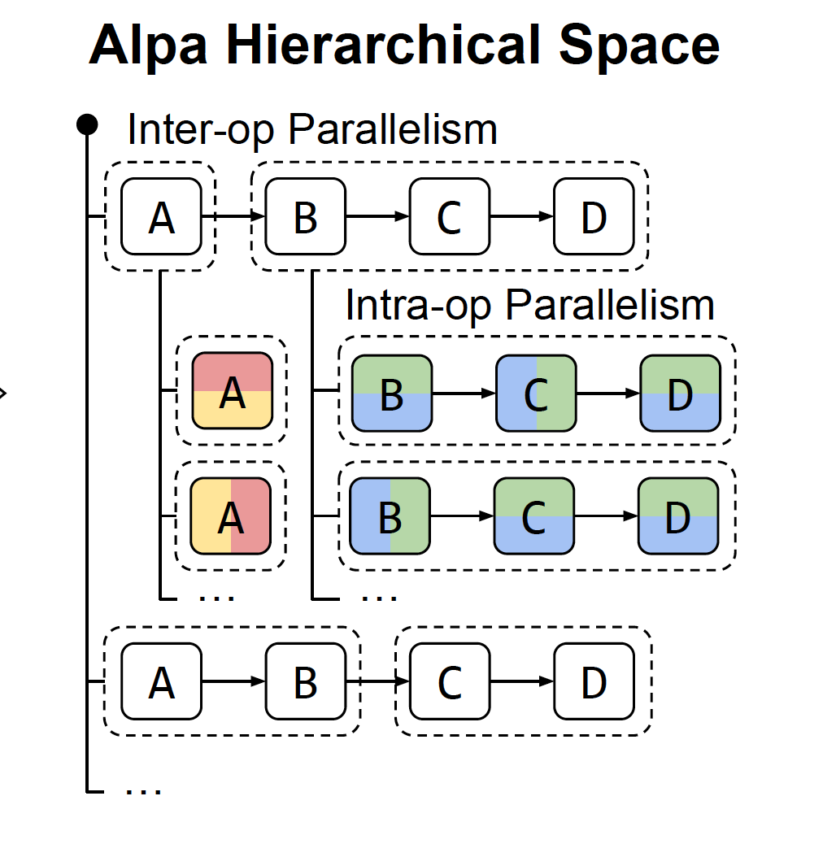
Two-level Hierarchical space to parallelism

Slide 35
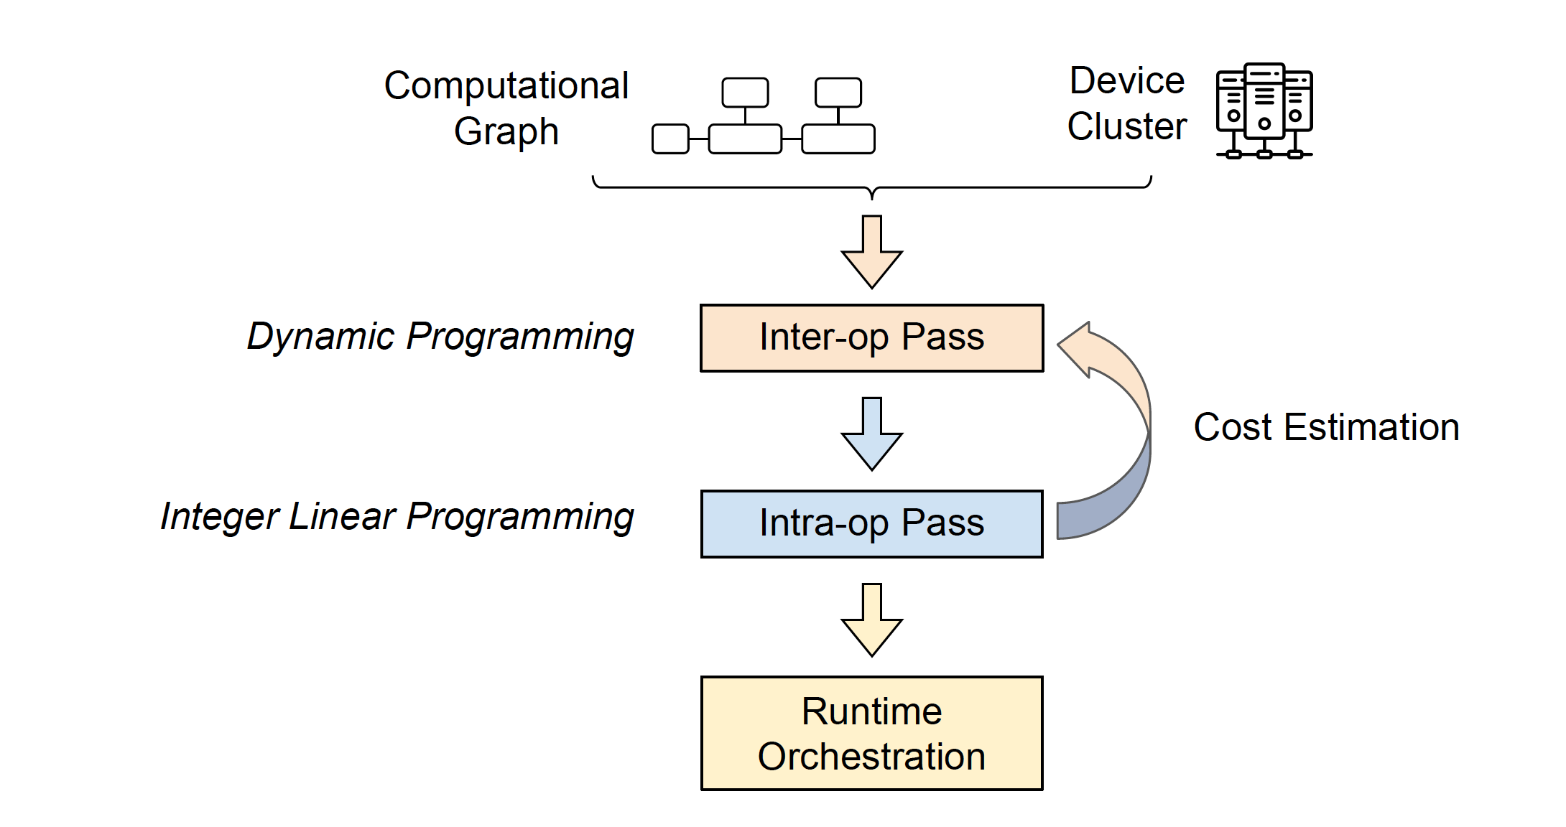
Alpa Compiler phase

Slide 36
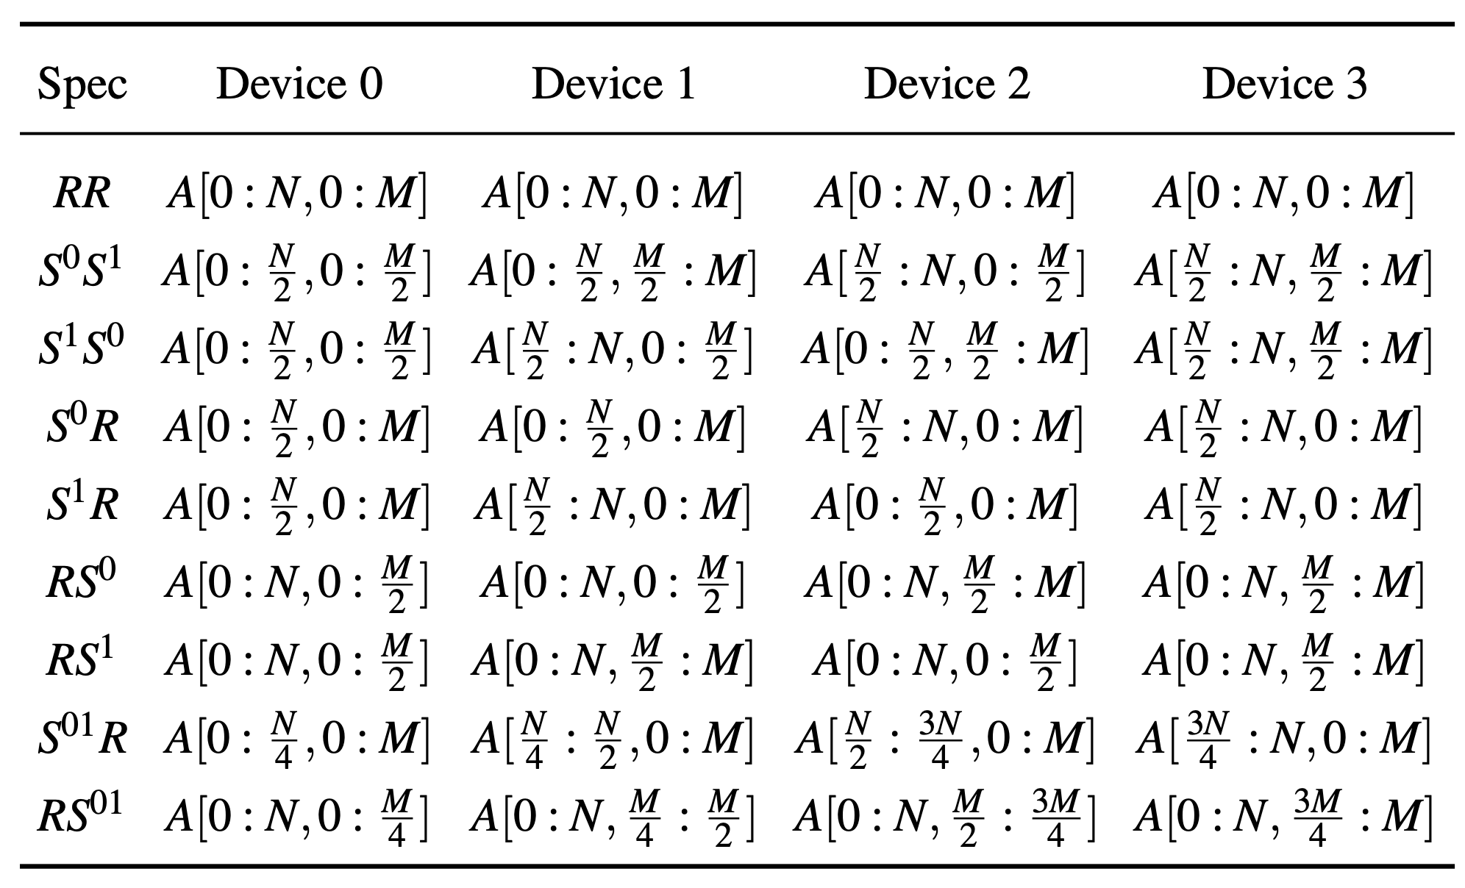
Intra-op pass
Possible A[N,M] mapping to 2x2 device

Slide 37
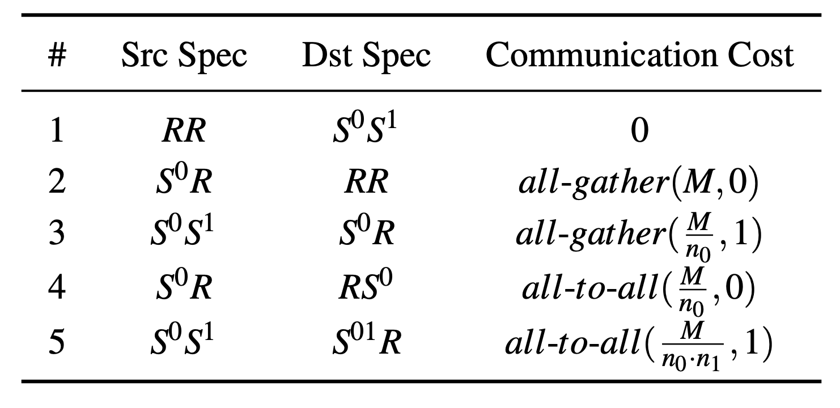
Communication cost of resharding
M is the tensor size, n0,n1 is the shape of the tensor

Slide 38
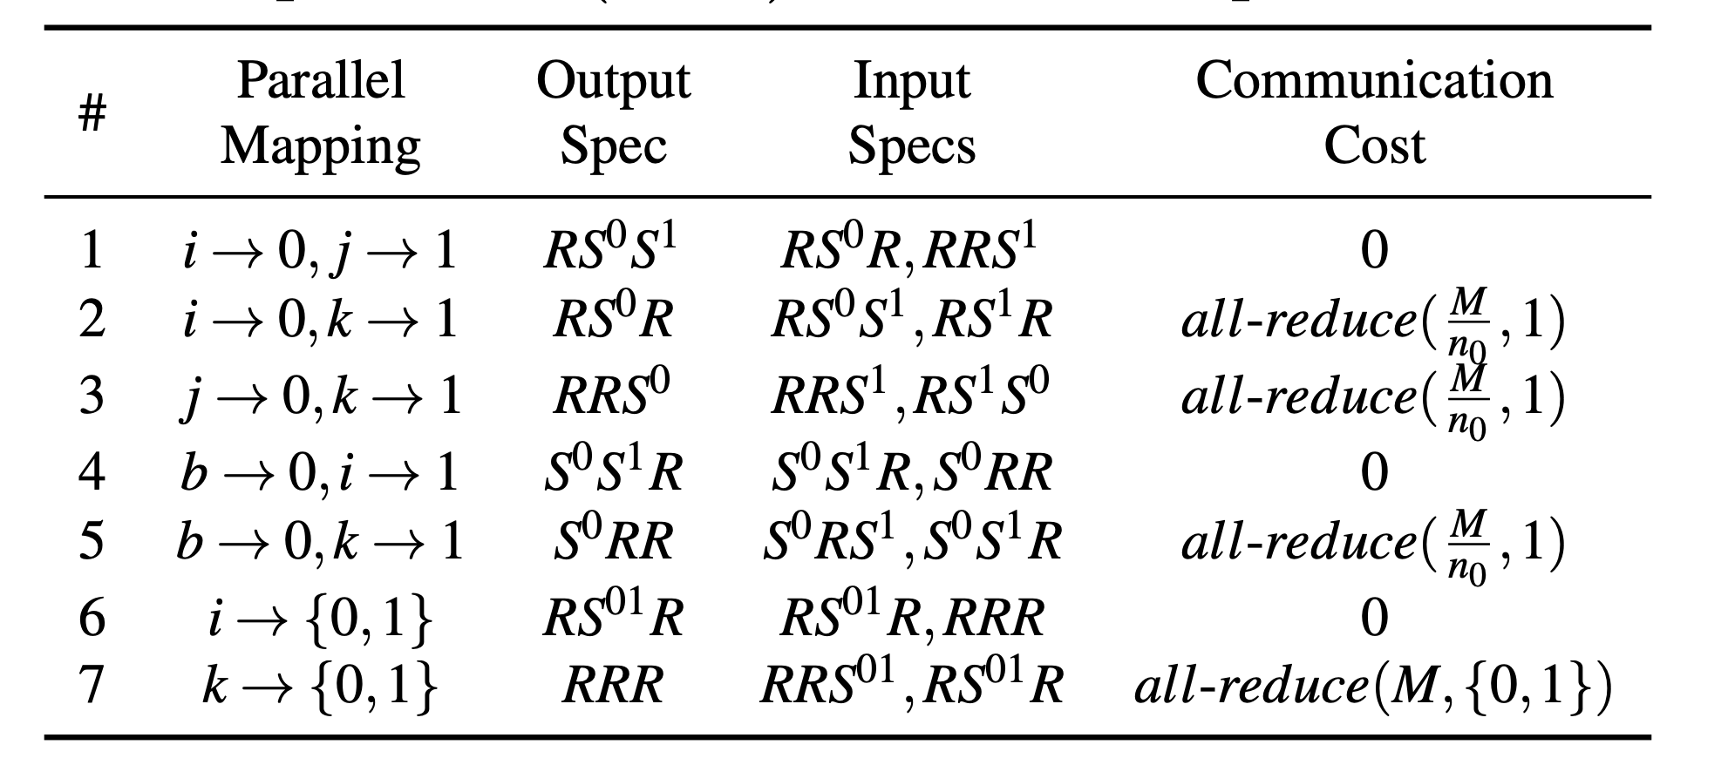
Parallel algorithums

Slide 39
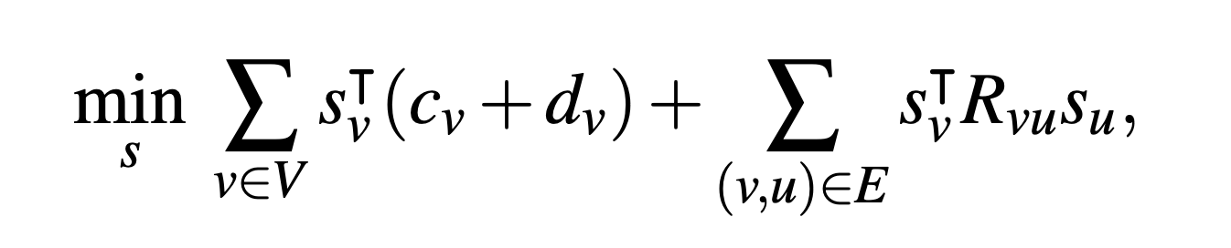
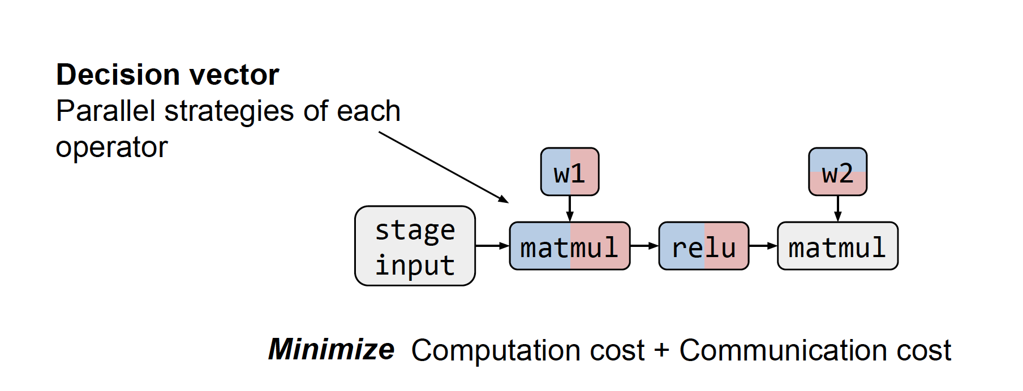
Intra-op parallelism models as a Integer Linear Programming problem
Notes:
C : communication cost vector, D: compute cost , Rvu is resharding cost

Slide 40
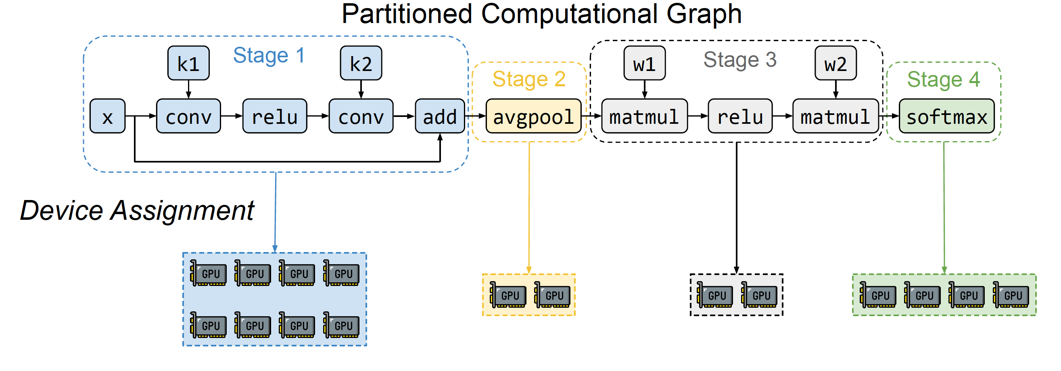
Inter-op parallelism
Graph partition and device assignment within one compiler stage

Slide 41
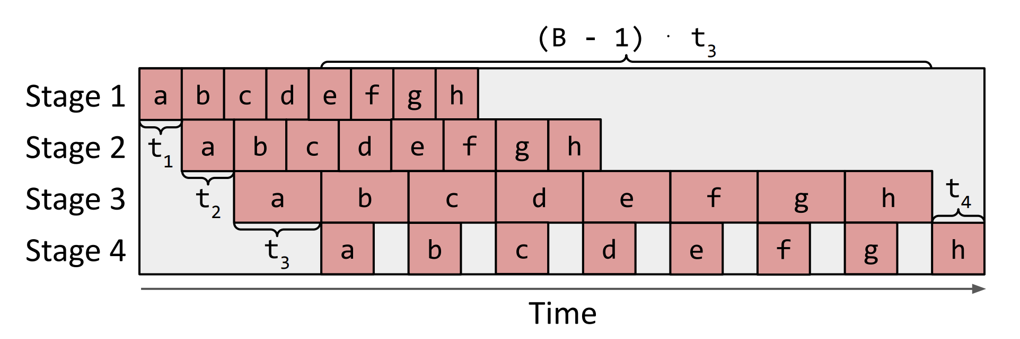
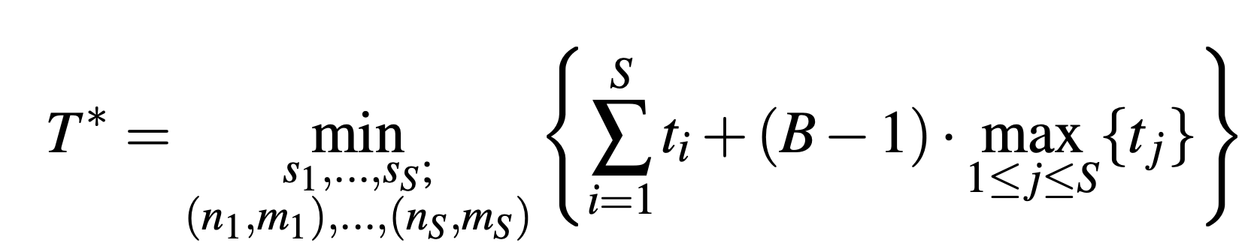
Inter-op parallelism
Time = (t1 + t2 + t3 + t4) + (B-1) t3
Generalized objective function

Slide 42
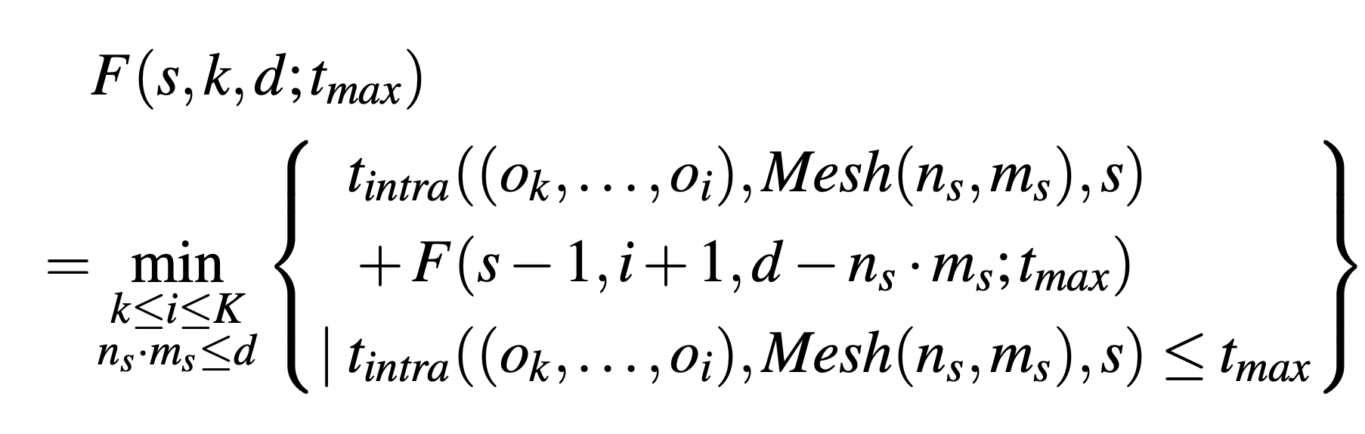
Dynamic Programming Formulation of Inter-op parallelism optimization
s: subsequent stages
(o_{k},…,o_{i}): Subgraph
d: devices

Slide 43
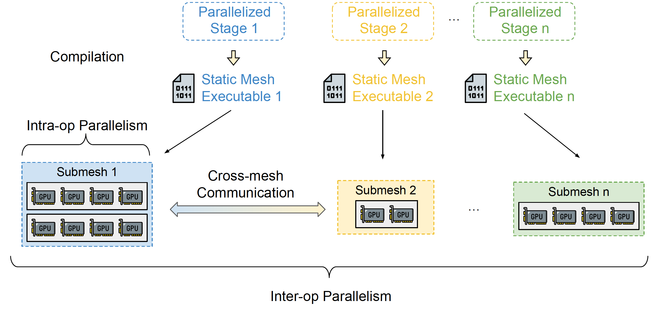
Run time execution

Slide 44
SOTA systems in large model distributed Training
Data/Model Parallelism
Megatron-LM
Mesh-Tensorflow
GShard
Megatron-LM-v2
Tofu
Flexflow
Alpa
UniDDL
GPipe
PipeDream
Pipeline Parallelism
Automatic

Slide 45
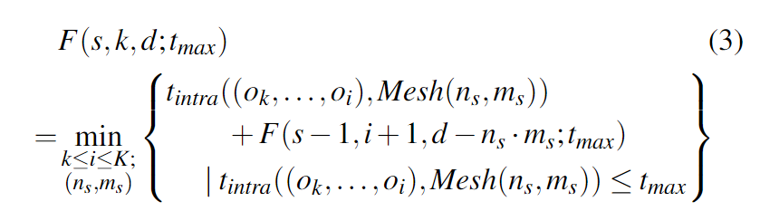
DP algorithm in pipeline parallelism(Prior Work)
Problem of current DP algorithm (e.g. Alpa)
Better algorithm (PipeDream) should be considered
Bubble: bubbles increases with more stages
Pipeline schedule: the longest stage dominates the training time
Communication between stages should also be considered
DP in Alpa
2 stages
4 stages

Slide 46
UniDDL Optimization vs Alpa
Parallel(4) indicates the number of minibatches foreach iteration
 |  | Iteration(ms) | forward | backward | optimizer
Alpa | serial | 157.84
 | Parallel | 108.66
UniDDL(0.1) | Serial | 180 | 54.56 | 107.36 | 17.05
 | Parallel（4） | 75.91(1.43x) | 21.78 | 34.78 | 3.59
 | Parallel（8） | 79.38(1.36x) | 12.46 | 29.52 | 3.63

Slide 47
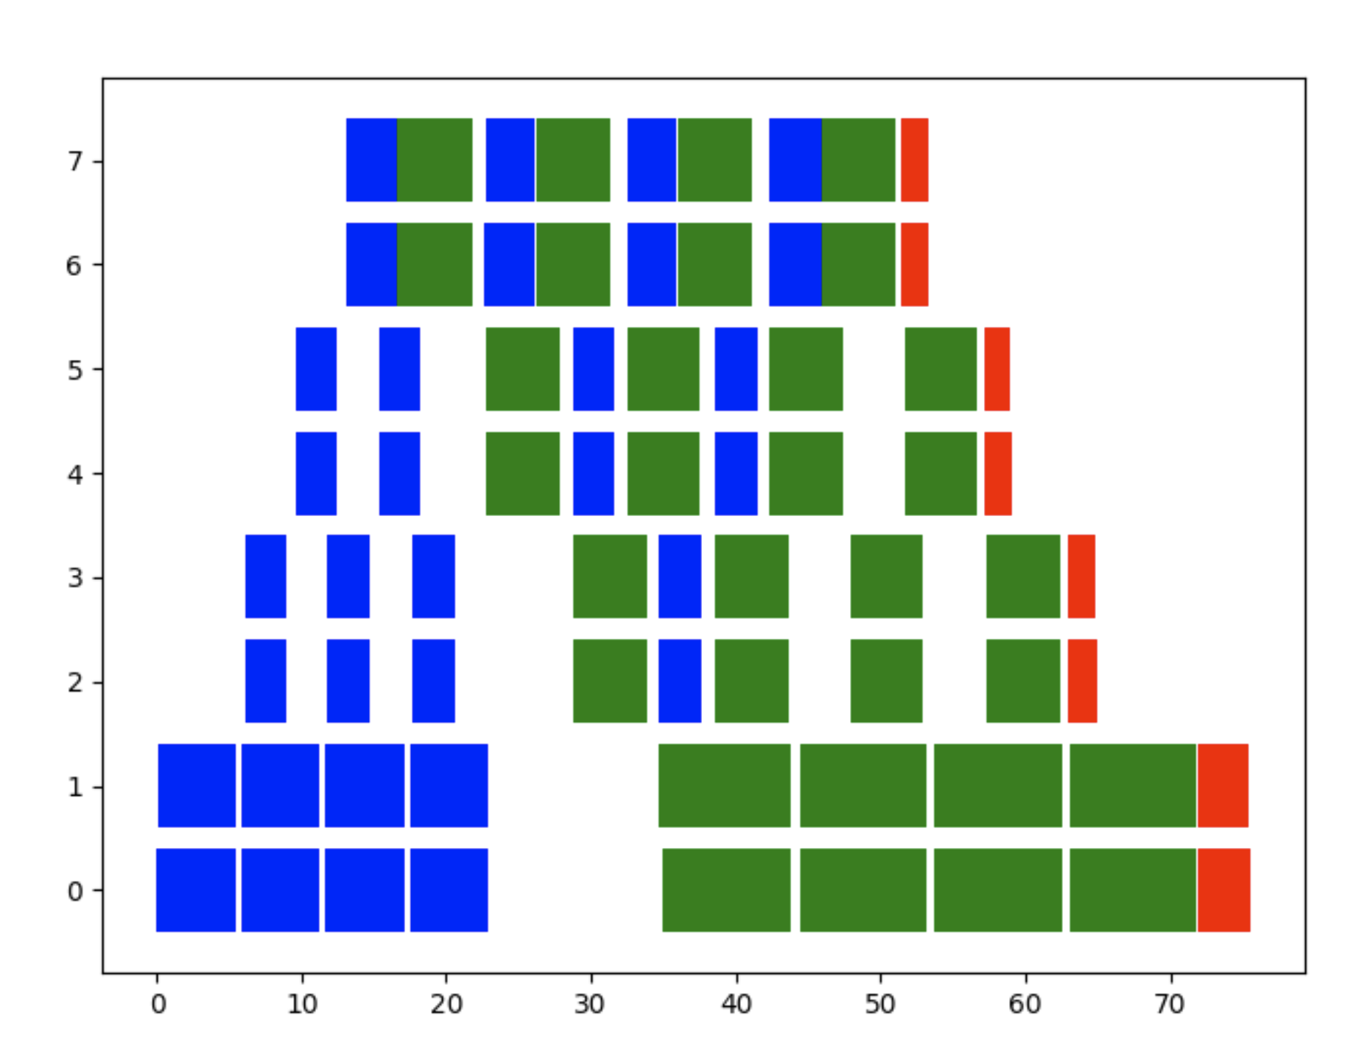
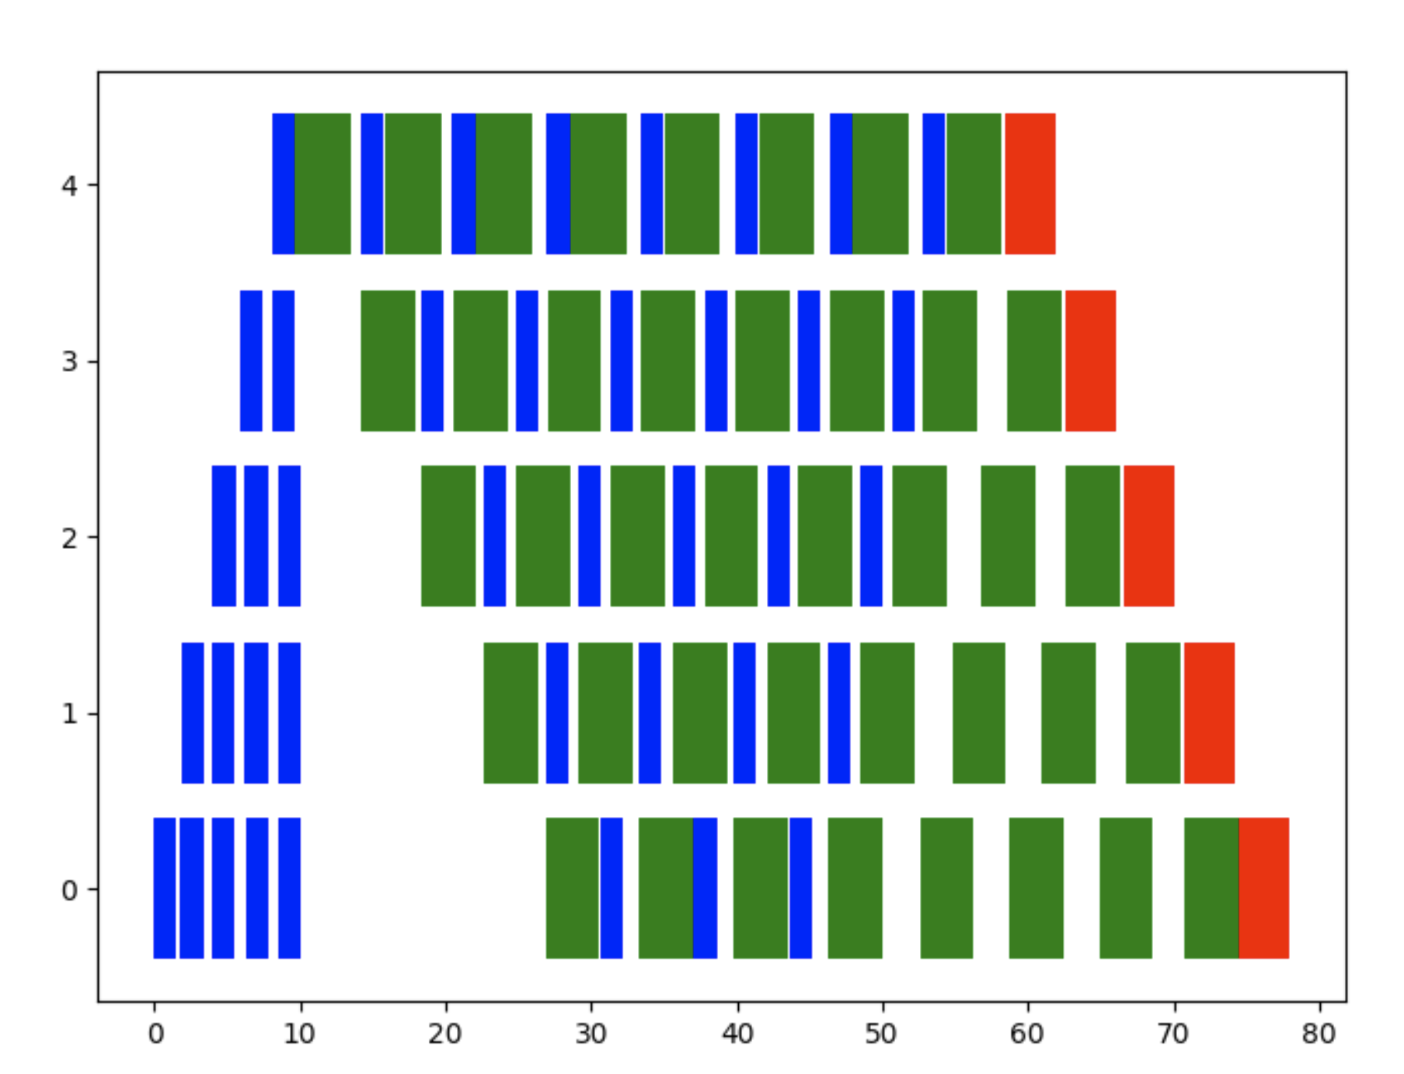
Num micro batch=4
Num micro batch=8

Slide 48
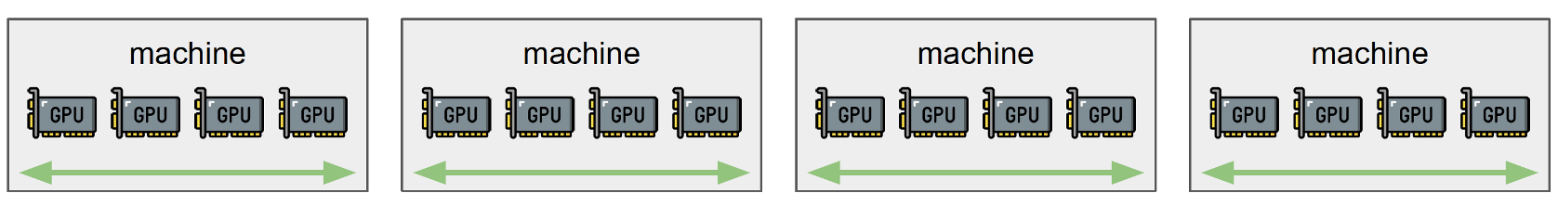

Training on distributed data centers

Slide 49
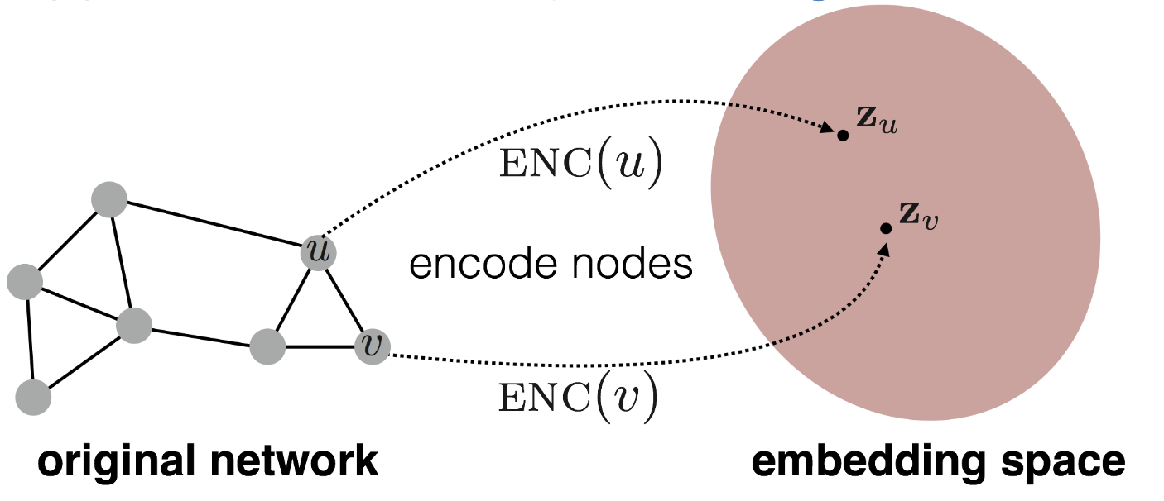
Conclusion
Machine learning systems are evolving fast
Large models seems promising
Even larger model training, up to 100T parameters
Train huge model with small clusters (ZeroInfinity[1])
Graph neural network
Captures the connections between entities
Extensive applications in industry
Huge space to improve in GNN systems
Representation Learning on Networks, snap.stanford.edu/proj/embeddings-www, WWW 2018
[1] Rajbhandari, Samyam, et al. "ZeRO-Infinity: Breaking the GPU Memory Wall for Extreme Scale Deep Learning." arXiv preprint arXiv:2104.07857 (2021).

